Slide 1
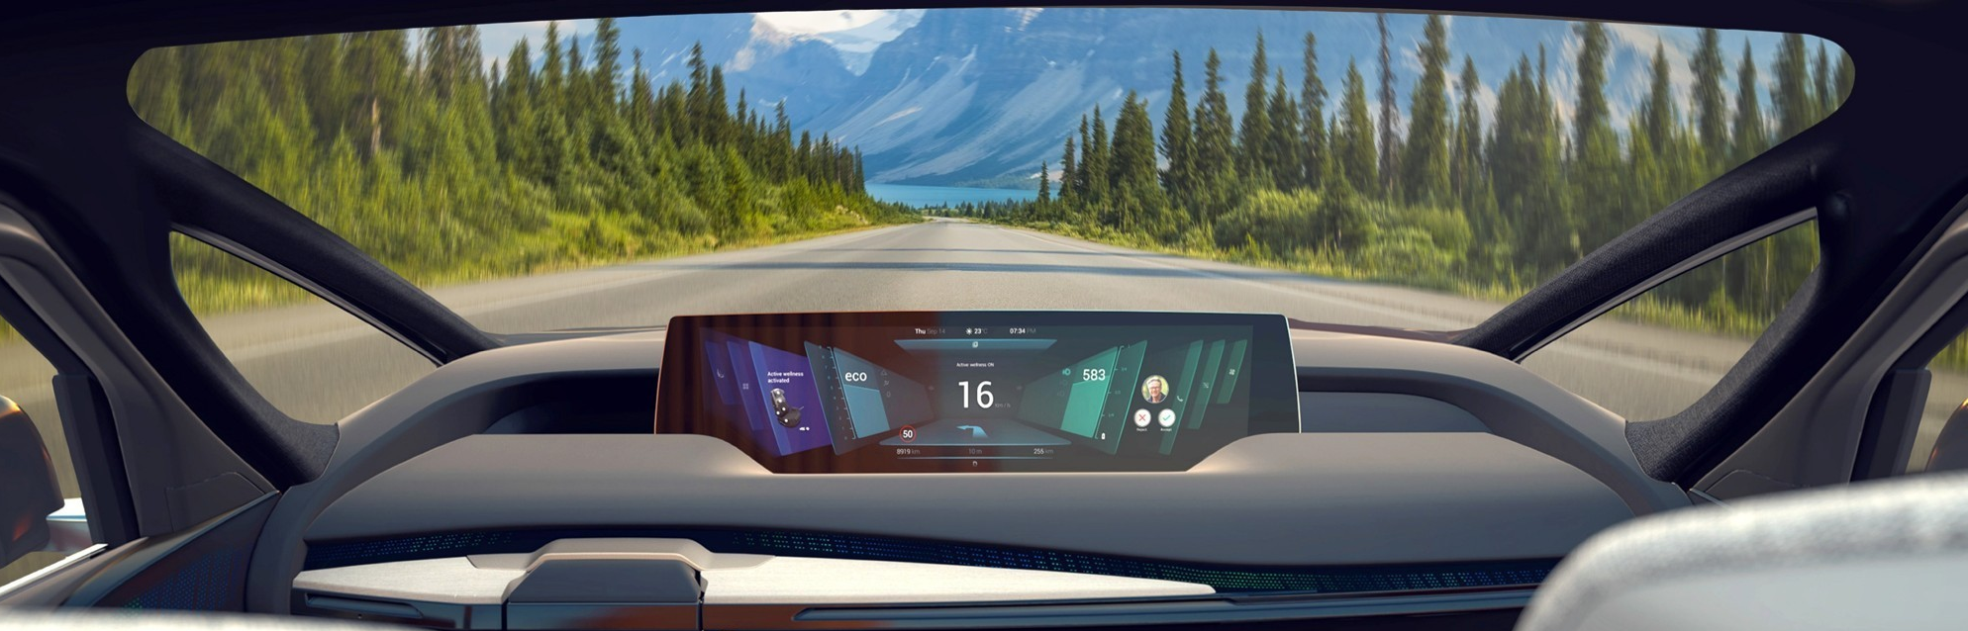
ARIBA
Frequently Asked Questions

Slide 2

Your Frequent Asked Questions about Ariba
Do we have to register at Ariba platform to continue working with Faurecia?
1
Can the PO’s that were made before Ariba registration be processed on the platform?
2
Is there any cost for our company to start using Ariba Platform?
3
What are the steps to register on Ariba Platform?
4
Our company already owns an Ariba account. What should we do?
5
What do I do if I received several registration invitations for the same legal entity?
6

Slide 3

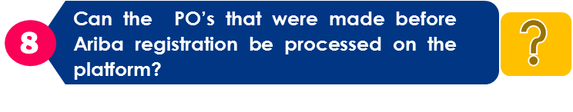
Your Frequent Asked Questions about Ariba (2)
I received several registration invitations for different legal entities of supplier. Why?
What are the procedures regarding PO’s / Invoices?
Can we check the status of PO’s / Invoices ?
9
Enterprise Enablement Process
10
11
Ariba Help Center & Support
12
Enterprise vs Standard Account

Slide 4

Answers Regarding Ariba
1
2
3
4
5
6
7
Do we have to register at Ariba platform to continue working with Faurecia?
Yes. To continue working with Faurecia it is highly recommended to have an Ariba account. Standard accounts are free.
If you do not create an Ariba account, purchase orders (POs) will be sent by email but you will not have access to any other functionality (like Invoice Status Portal).

Slide 5
Answers Regarding Ariba
2
3
4
5
6
7
8
Can the PO’s that were made before Ariba registration be processed on the platform?
No. Only purchase orders created in Ariba can be processed on the platform.

Slide 6
Answers Regarding Ariba
1
2
3
4
5
6
7
Is there any cost for our company to start using Ariba platform?
No. A Standard account is free. However, you will have a limited set of functionalities. It is recommend to have an Enterprise account to get the maximum benefits of the registration to Ariba.
If you have an Enterprise account, Faurecia can support Ariba fees. Please, contact your Faurecia Buyer, to have more information

Slide 7
Answers Regarding Ariba
4
1
2
3
5
6
7
What are the steps to register on Ariba platform?
Your company may register an account on the SAP Ariba Network by visiting Ariba website http://supplier.ariba.com and clicking the 'Register Now' link.
  Once you click the Register Now link, you will be taken through the 3 step registration process as follows:
    Enter your Company Information. Please note only fields marked with an asterisk (*) are required.
    Enter the User account information. Please note only fields marked with an asterisk (*) are required.
    Review the information on the page, check the box I have read and agree to the Terms of Use and the SAP Ariba Privacy Statement at the bottom of the page and click Register.
  You will be taken to a page that says, Thank you for registering on SAP Ariba Network and receive an activation e-mail once you have successfully registered your account.
  This registration is independent of your activity with Faurecia. You need to receive an invitation to connect your account with Faurecia. Invitation can be a Trading relationship Request or any document sent by Faurecia (RFx, Order, Invoice). See next page.

Slide 8
Answers Regarding Ariba
1
4
1
2
3
5
6
7
What are the steps to register on Ariba platform? (2)
Registration through an email:
  If you received an email invitation from Faurecia, click the link in the email message. When Ariba Network shows the welcome page, do one of the following:
    If you already have an account, click Log in.
    If you don't already have an account, click Sign up.
  If you received a purchase order welcome letter that contains a temporary ID and secure code, you can use a web browser to go to the web address contained in the welcome letter. Enter your temporary ID and secure code to activate the account. After you activate your account, the temporary ID becomes your username.
  If you received a purchase order or other first-time document from Faurecia, click the action button in the email, such as Process order. From the landing page, choose Sign up to register a free, Sandard account, or choose Log in to add the document to your existing Ariba Network account.

Slide 9
Registration
1
Click here

Slide 10
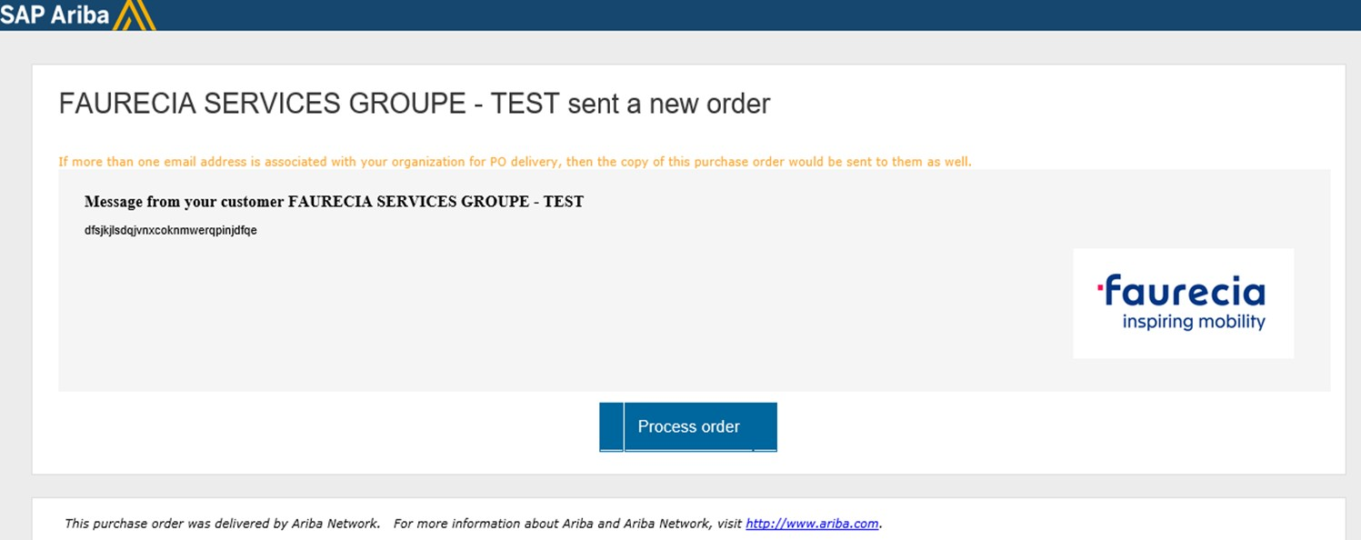
Registration
1
Click here

Slide 11
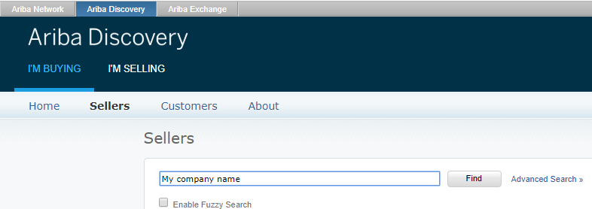
Answers Regarding Ariba
3
4
5
6
7
1
2
Our company already owns an Ariba account. What should we do?
When invited through a Trading Relationship Request or a Purchasing Document, please register with your existing account and do not create a new one.There must be only one ANID per legal entity
Faurecia’s ANID is AN01274677429.
In order to check if you already have an Ariba Account, we recommend you to check internally within your company by contacting your System Administrator. You can also inquire potential existing accounts in the following link, by typing your company name and region in search field https://service.ariba.com/Discovery.aw/

Slide 12
Answers Regarding Ariba
1
2
3
4
5
6
7
What do I do if I received several registration invitations for a same legal entity?
You have to register with the same Ariba Network ID to the several registration invitations

Slide 13
Answers Regarding Ariba
5
7
1
2
3
4
6
I received several registration invitations for different legal entities of a supplier. Why?
Because you are defined within Faurecia as Global Key Account Manager for this supplier.

Slide 14
Answers Regarding Ariba
2
3
4
5
6
7
8
What is the procedure concerning PO’s / Invoices?
Invoices can only be posted in Ariba if the related purchase orders (PO’s) have been created in Ariba.
Check Ariba help center if needed

Slide 15
Answers Regarding Ariba
7
8
9
10
11
12
Can we check the status of the PO’s / Invoices? (COMING SOON)
Yes. You will shortly be able to view purchase orders (POs) and invoice status at any time on SAP Ariba Network, which is extremely useful for managing your business.
  Invoices
    You can search for invoices by the exact invoice number, regardless of the date range.
    To run this search:
      Click the Outbox tab.
      Click the arrow in front of Search Filters to expand the filter options.
      Enter the invoice number in the Invoice Number field.
      Check the Exact Number radio button below the invoice number.
      Click Search.
      You can also search for invoices using other search filters in the Outbox

Slide 16

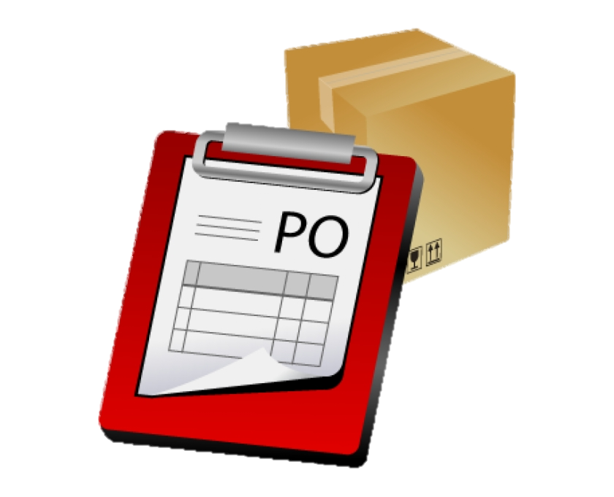

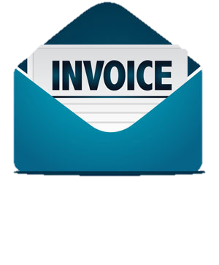
Enterprise Enablement Process
1
7
8
9
10
11
12
Activity
Account
Activity
Purchase Order
1
6
7
Approve the Activity
Configure PO routing and notifications
Purchase Order Sent
5
Accept Trading Relationship
2
Provided E-mail or Fax for TRR
4
Activity
Invoice
Accept Terms of Use of Ariba Network
3
8
9
Relationship Request
Configure Invoice routing and notifications
Invoice Sent
16
16

Slide 17
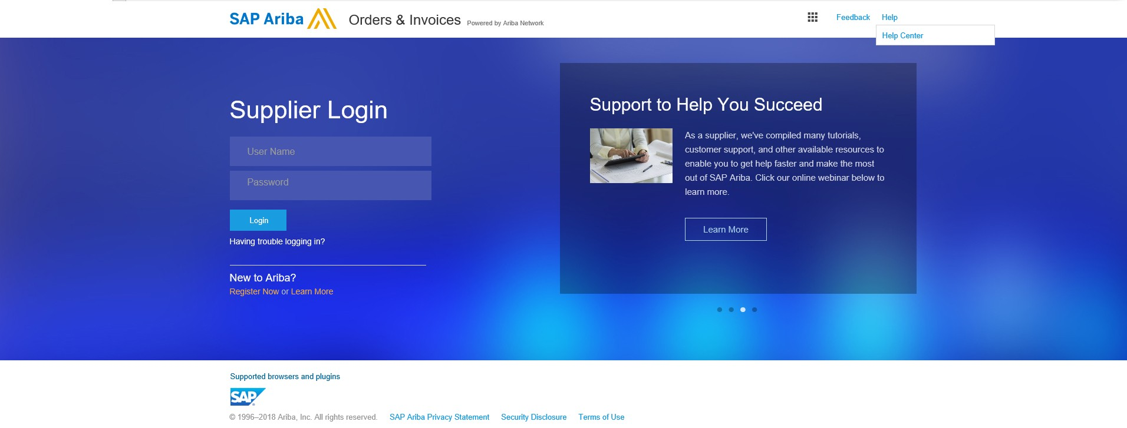

Help Center (1/2)
7
8
9
10
11
12
Activity
Account
It’s not needed to be connected to access the help center.
After you access the help center in a new window, you can take the following actions:
Activity
Invoice
Browse the help content in Popular Topics.
Search for specific content using the search bar at the top of the page.
Access the Learning Center to view product documentation and tutorials.
Go to the Support Center to contact SAP Ariba Customer Support.
Click Ask Community to post a question that other help center users can answer.
Access an unanswered question in the Can you help answer these questions? area.

Slide 18
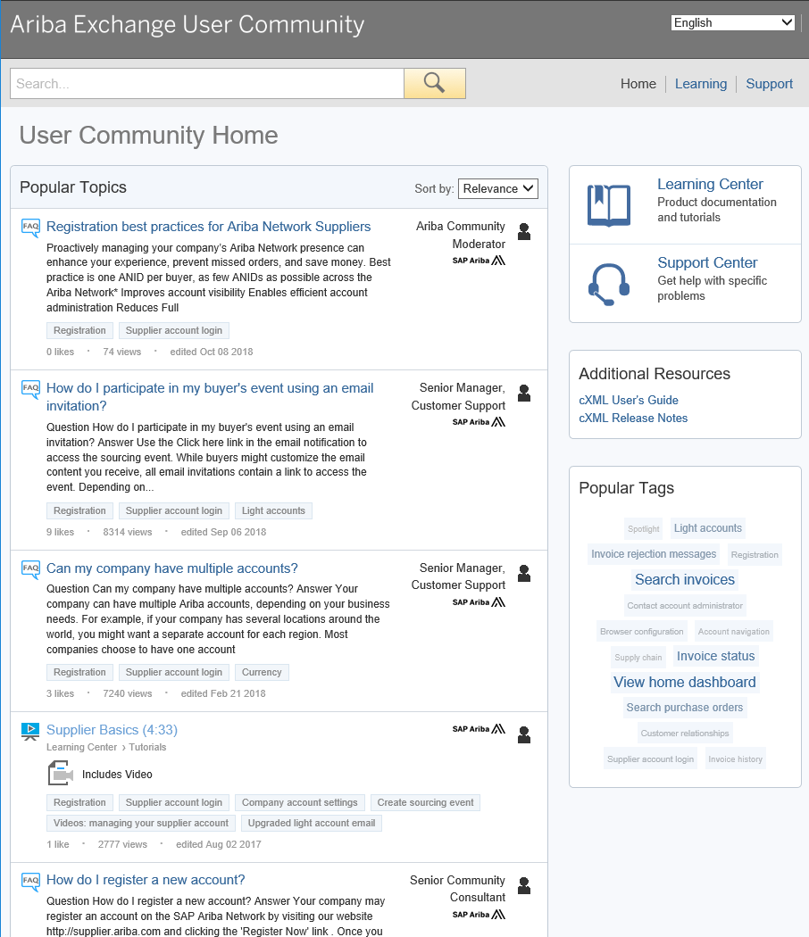
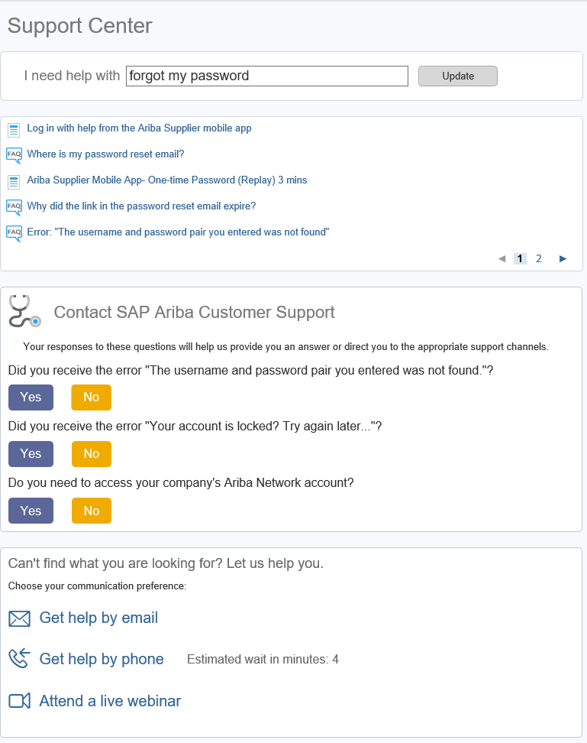

Help Center (2/2)
Search with key words
Try searching for whatever you need help with by using the I need help with search box.
If you need further support after conducting a search, the above mentioned support options will become available.

Slide 19
Contacts
Questions regarding Ariba usage :
Please click on one of the below links for any questions regarding registration, configuration or general Ariba Network questions :
  USA/Canada : https://connectsupport.ariba.com/sites/Company?ANID=AN01274677429NAM&h=efiEiEb9GzUpOl83jqsNw#Enablement-Inquiry
  Brazil : https://connectsupport.ariba.com/sites/Company?ANID=AN01274677429BRZ&h=ZUMjmQJ1cv1AyRPHP4rNzA#Enablement-Inquiry
  Latin America: https://connectsupport.ariba.com/sites/Company?ANID=AN01274677429LAC&h=1a9ipmjaTdbyL4I4jaUcg#Enablement-Inquiry
  EMEA: https://connectsupport.ariba.com/sites/Company?ANID=AN01274677429EMA&h=aYCJ5Mm2uFBJv1T7QaeZ9A#Enablement-Inquiry
  SE Asia: https://connectsupport.ariba.com/sites/Company?ANID=AN01274677429SEA&h=kRV62sa3KWxd5CoBSswQ#Enablement-Inquiry
Questions regarding your relationship with Faurecia :
  EMEA
    Enterprise account : supplier.enablement.emea@faurecia.com
    Standard account : light.enablement.emea@faurecia.com
  North America
    Enterprise accounts : full.enablement.nao@faurecia.com
    Standard accounts : light.enablement.nao@faurecia.com
  China:
    Enterprise accounts : supplier.enablement.asia@faurecia.com
    Standard accounts : light.enablement.asia@faurecia.com

Slide 20
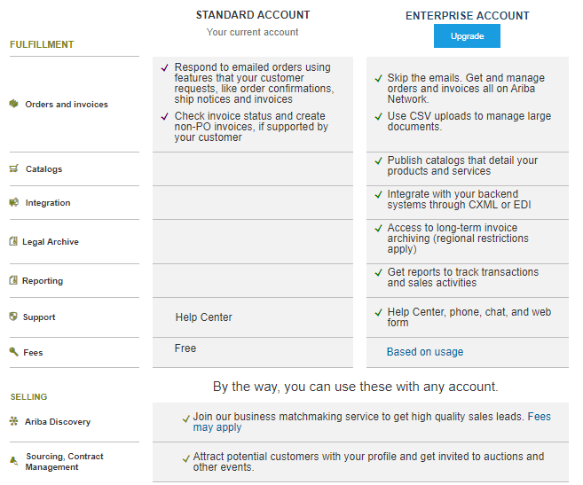
Enterprise vs Standard account (1/2)
7
8
9
10
11
12

Slide 21
Enterprise vs Standard account (2/2)
7
8
9
10
11
12
STANDARD ACCOUNT, YOUR ACCOUNT BY DEFAULT after registering to Ariba, enabling you to:
  Respond to emailed orders
  Make orders confirmation
  Make ship notices
  Send invoices
In case you are processing amounts of POs > 100 per year and / or have catalogs, you may have access to :
ENTERPRISE ACCOUNT enabling you to use advanced features:
  Fully seamless digital interaction, email reduction
  Advanced Activity archivation stored in the Cloud
  Catalog creation, publication, management
  Invoices Management
For more information about Enterprise Account and on eligibility rules, please contact your Faurecia Buyer

Slide 22


