Slide 1

How to: Steps for Registering and interact with Ariba
September 2019
Version 6

Slide 2
Summary
1
How to register
- Registration from a PO
- Registration from a Buyer Invitation
- Qualification questionnaire
2
How to use interactive email
- Send order confirmation
- Create shipment notice
- Create invoice
3
How to get support

Slide 3
First Contact – The Supplier will receive an invitation from Faurecia
Different channels of Invitation - Registration
1
Invite to register may come by e-mail, PO, RFQ, etc
Registration is free and highly recommended to work with Faurecia
NOTICE: If you already have an Ariba Account, you don’t have to register again; just connect into to register as a Faurecia Supplier in Ariba Network.

Slide 4
First Contact – The Supplier will receive an invitation from Faurecia
Registration from a PO
1A

Slide 5
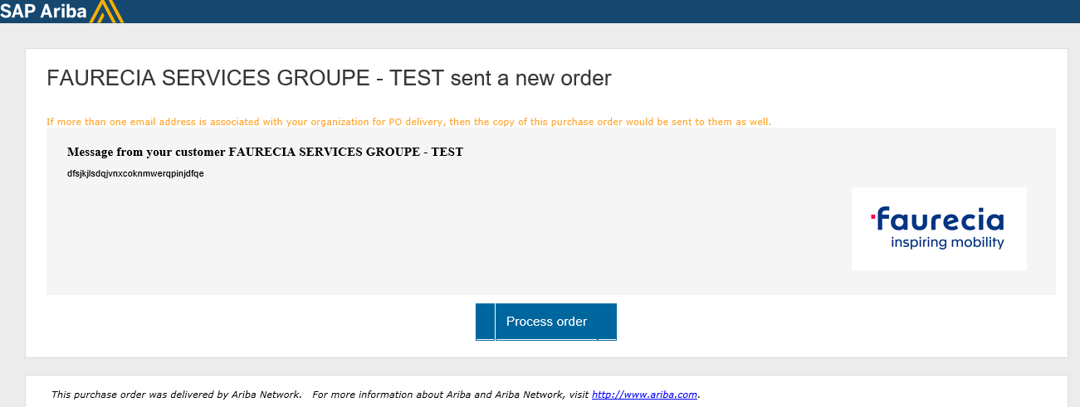
First Contact – The Supplier will receive an invitation from Faurecia (2)
Registration from a PO
1A
In the PO e-mail you receive, click “Process order”
  Registration only works by invitation from Faurecia

Slide 6
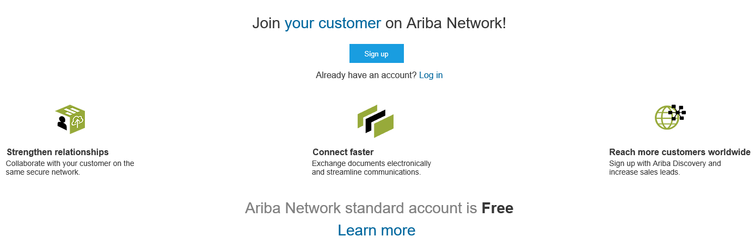
Registration - Step 1
1A
1
It will direct you to the Ariba Network connection page
Click the “Sign up” button if you don’t have an Ariba Account
Click “Log in” if you already have one
1
2

Slide 7
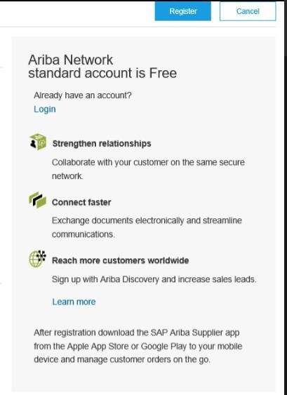
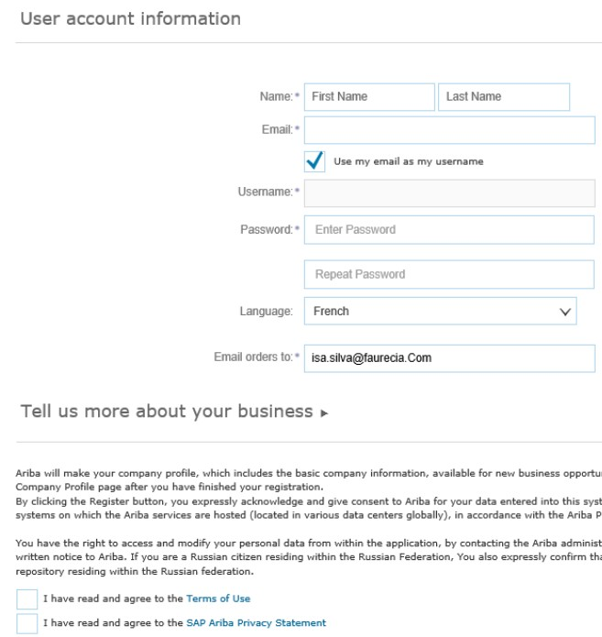
Registration - Step 2
1A
1
You will be directed to the registration page
Fill in all the required fields with your information
Agree with the “Terms of use” and “SAP Ariba Privacy Statement”
Finalize by clicking “Register”
2
1

Slide 8

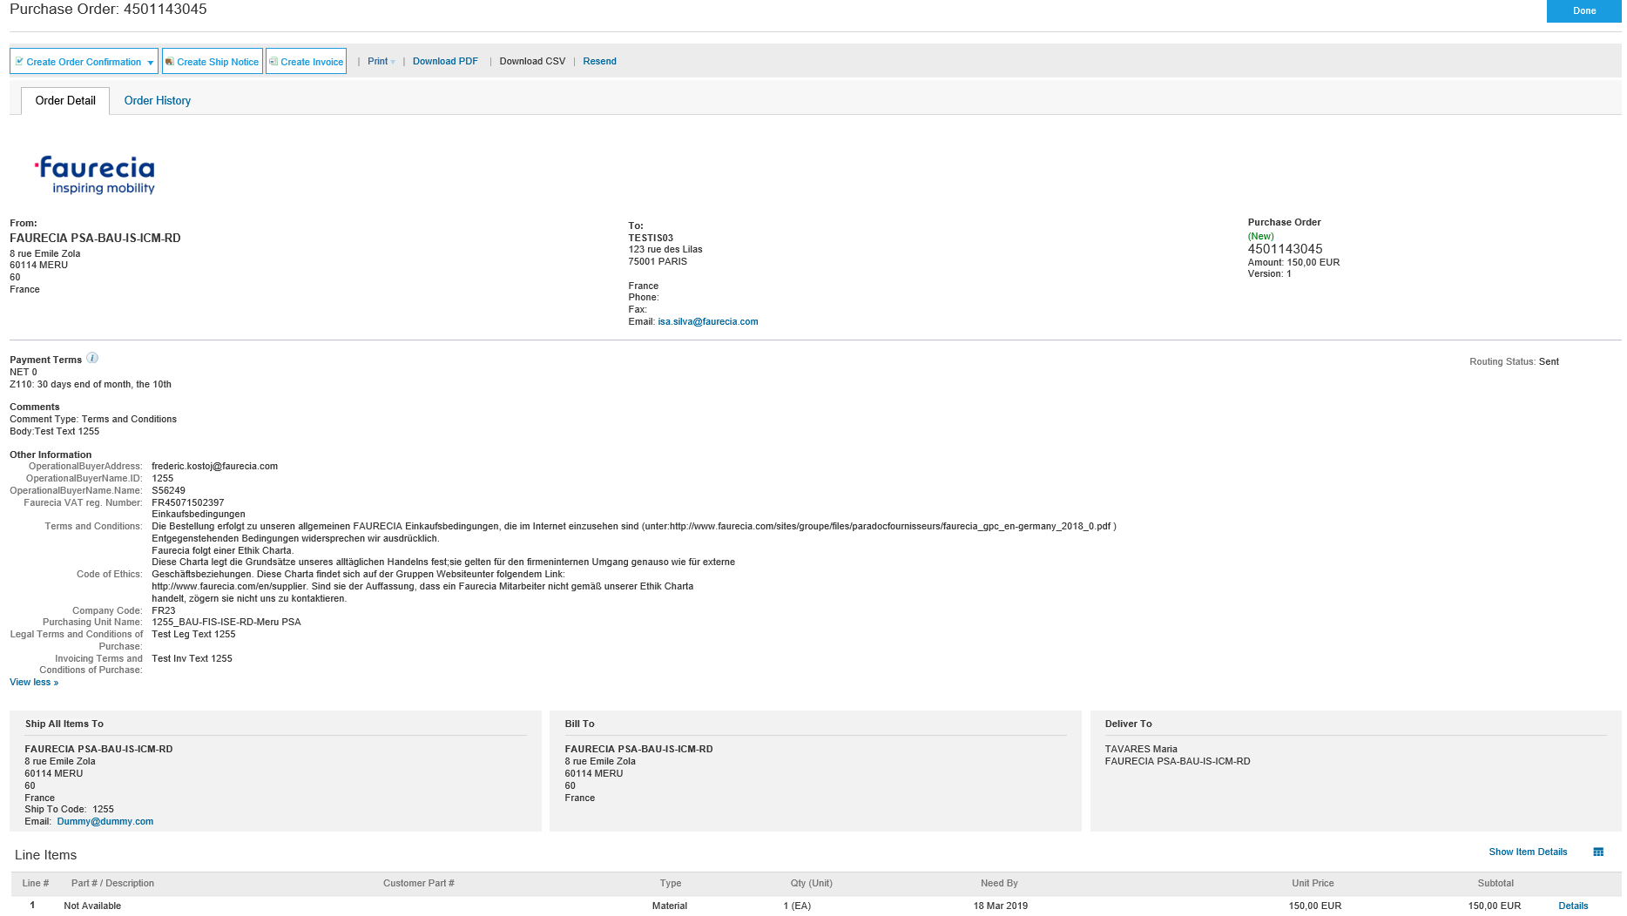
Registration - Step 3
1A
You will be redirected to the PO
Click “Done” when finished
1

Slide 9
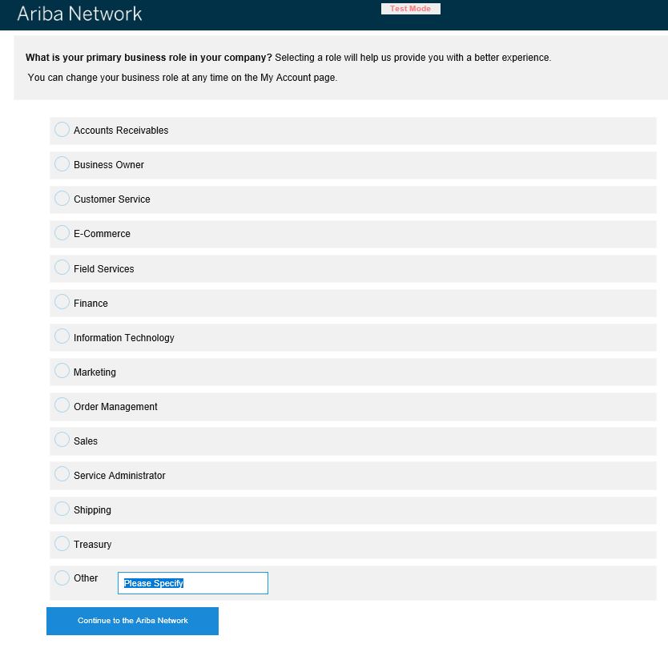
Registration - Step 4
1A
1
You will be directed to this configuration page
Select one option
Click “Continue to the Ariba Network” to finalize

Slide 10
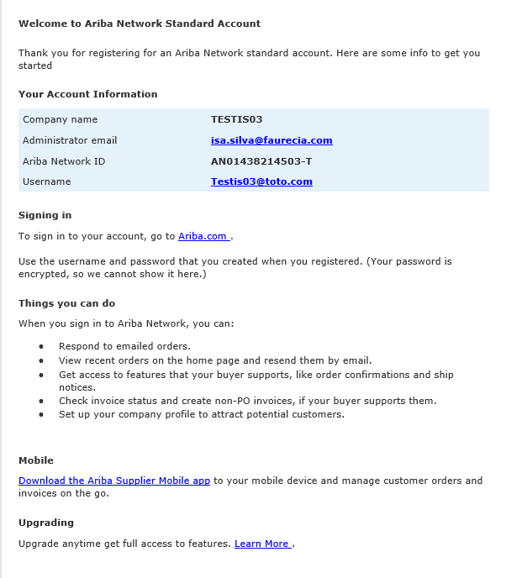
Registration - Step 5
1A
1
You will get an e-mail confirming the registration with your User Name and Ariba Network ID
Click “Ariba.com” to sign in to your account

Slide 11
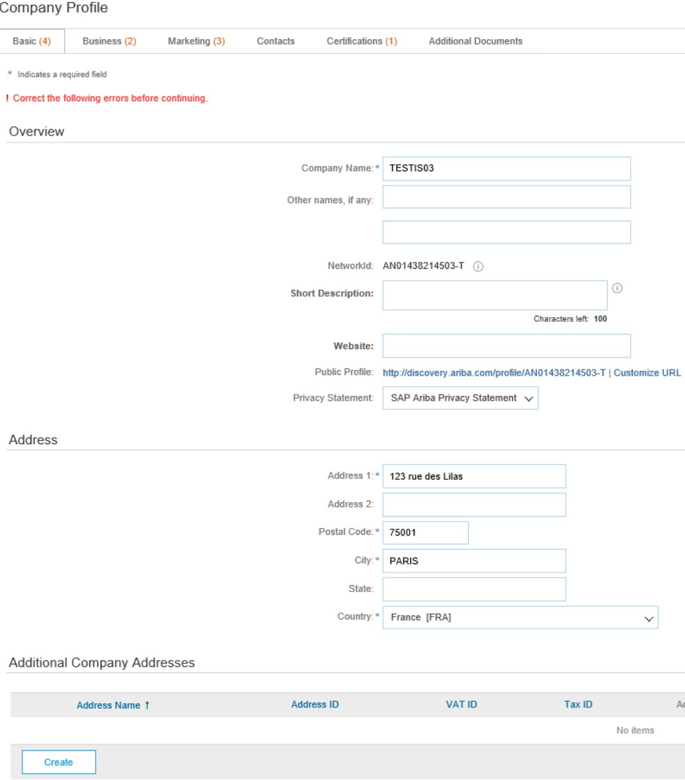
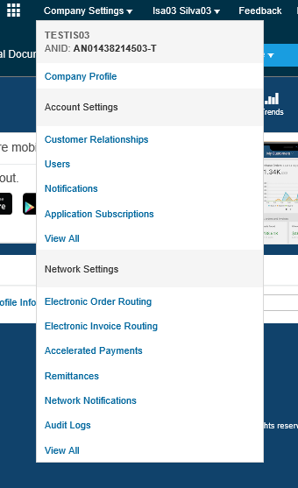
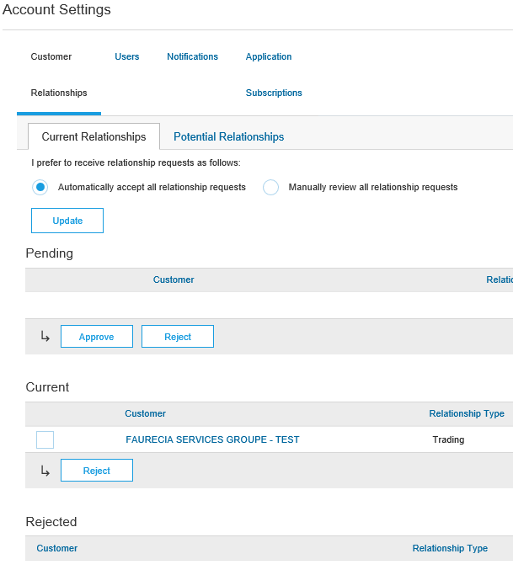
Registration - Step 6
1A
1
You will be directed to the main page of Ariba Network
Go to “Company Settings”, fill in the required information and the registration is complete

Slide 12

Registration Complete!

Slide 13
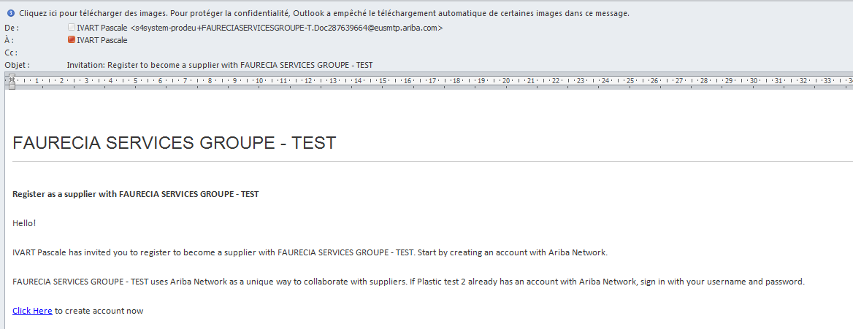
First Contact – The Supplier will receive an invitation from Faurecia
Registration from a Buyer Invitation
1B
Click on the Link “Click here” to be directed to the Ariba Network connection page

Slide 14

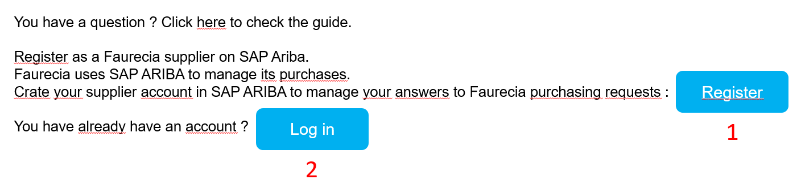
Registration - Step 1
The language displayed will be the one of your supplier PC / location
Click the “Sign up” button if you don’t have an Ariba Account (1)
Click “Log in” if you already have one (2)

Slide 15
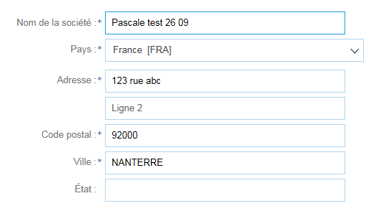

Registration - Step 2
Once clicked on “Register” button
Once clicked on « register » , fill in all the required fields with your information
NB: All information with a * are mandatory
Mail and email Addresses
Delivery location (world, country, etc)
Contact name
Language
Password to access to Arina Network interface with Faurecia
All the Product/Service categories to be supplied for faurecia
Fiscal ID, DUNS
Agree with the « terms of use » and SAP Ariba Privacy Statement
Once completed, click at the bottom of the page : « create an account & continue »

Slide 16
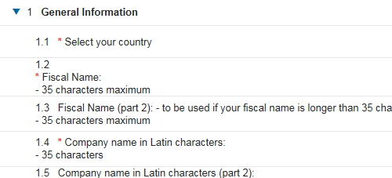
Registration - Step 3
You will be directed to an other form regarding General Information - Fill in all the required fields with your information
NB: You must specify address in local and latin language for deliveries

Slide 17
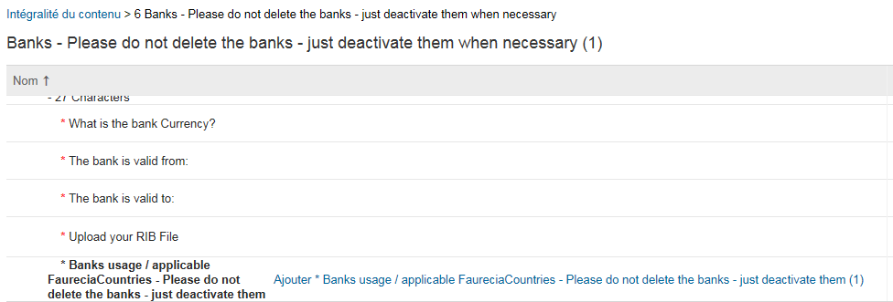
Registration - Step 4
Bank account information Form (1/3) : Fill in all the required fields with your information

Slide 18
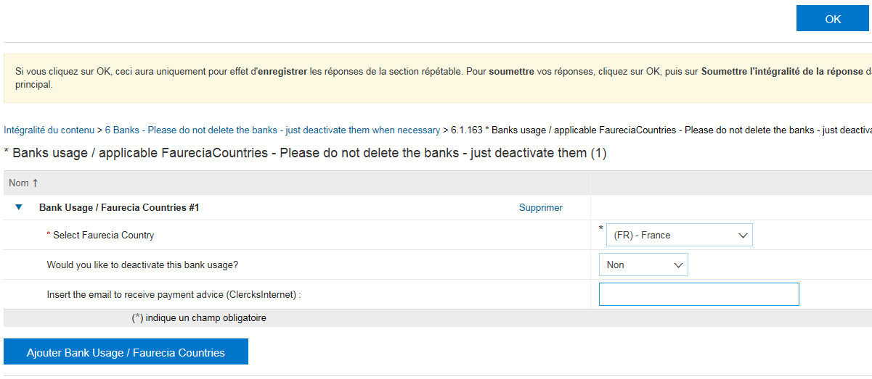
Registration - Step 5
Click on “Add Bank Usage / Faurecia countries”button (1)
Then fill required information (2)
Then click on “OK” button when completed (3)
Bank account information Form (2/3):
3
2
1

Slide 19
Registration - Step 5
Click on “Add Bank Usage / Faurecia countries”button (1)
Then fill required information (2)
Then click on “OK” button when completed (3)
Bank account information Form (2/3):
3
2
1

Slide 20
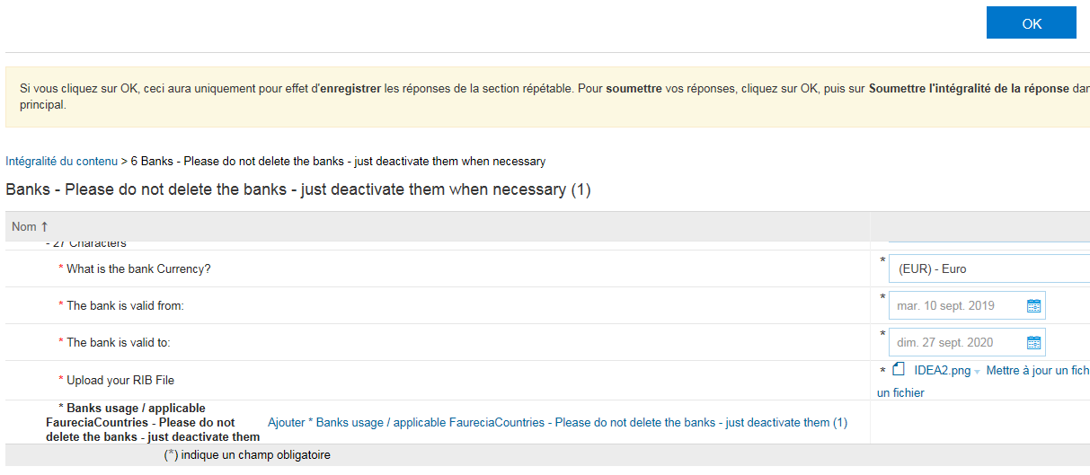
Registration - Step 6
Click on “OK” button when completed
Bank account information Form (3/3):

Slide 21
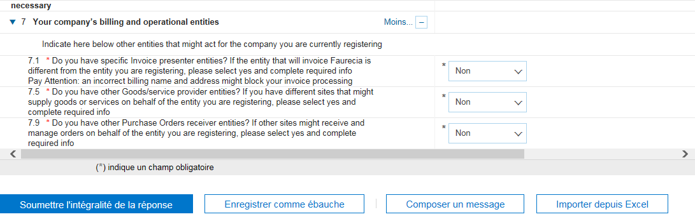
Registration - Step 7
Fill in all the required fields with your information
Verify and click on « Submit » Button

Slide 22
Registration Complete!

Slide 23
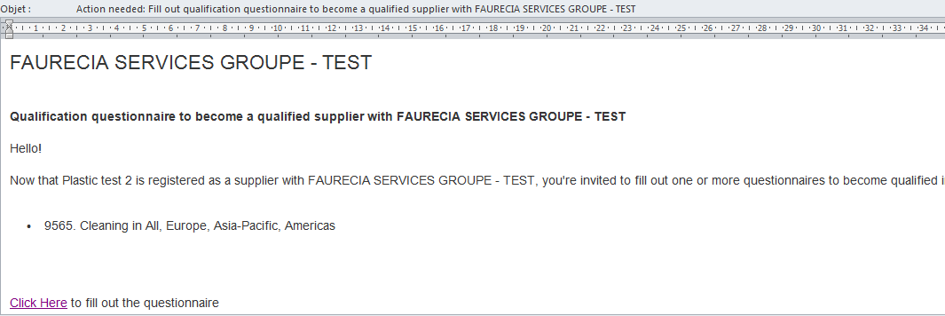
The Supplier will receive a Qualification Questionnaire from Faurecia by mail
1C
Click on the email notification to fill questionnaire and be able to sell & deliver on the right segments / locations

Slide 24
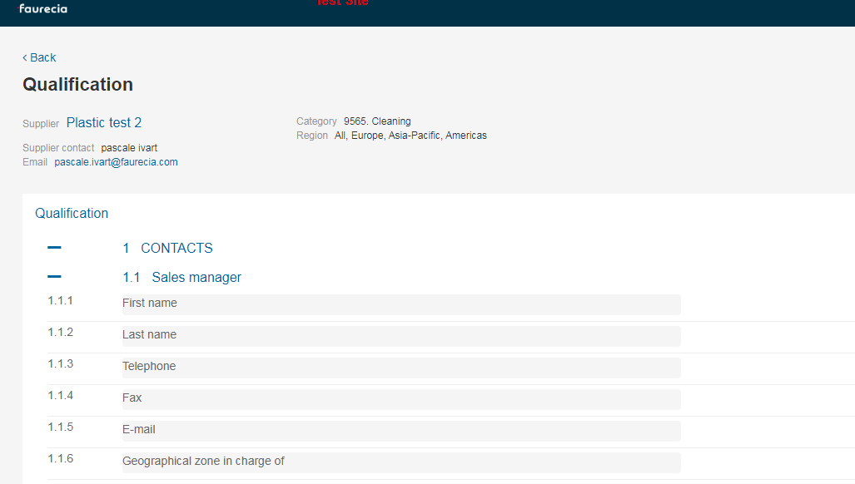
The Supplier performs Qualification Questionnaire
1C
Fill/verify key elements and data such as :
  Turnover data
  Staff data (number of employees, quality director name, etc.)
  Key product/services delivered to Faurecia description, location, volume
  Etc.

Slide 25
Qualification Process Complete!

Slide 26
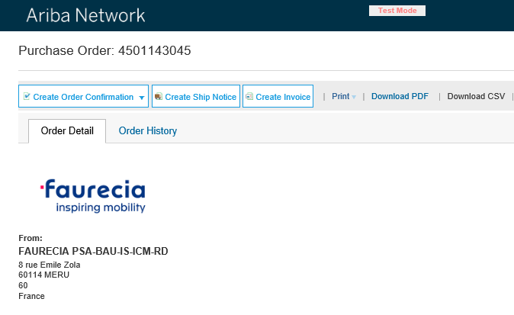
After registering: How to use the interactive e-mail
2
In the received PO e-mail you will have three options
  Create Order Confirmation
  Create Ship Notice
  Create Invoice (invoices are not available yet)

Slide 27
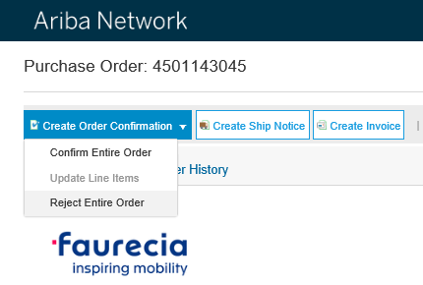
How to use the interactive e-mail – Create PO confirmation
Confirm Entire Order
2
In Create Order Confirmation you have two options:

Slide 28
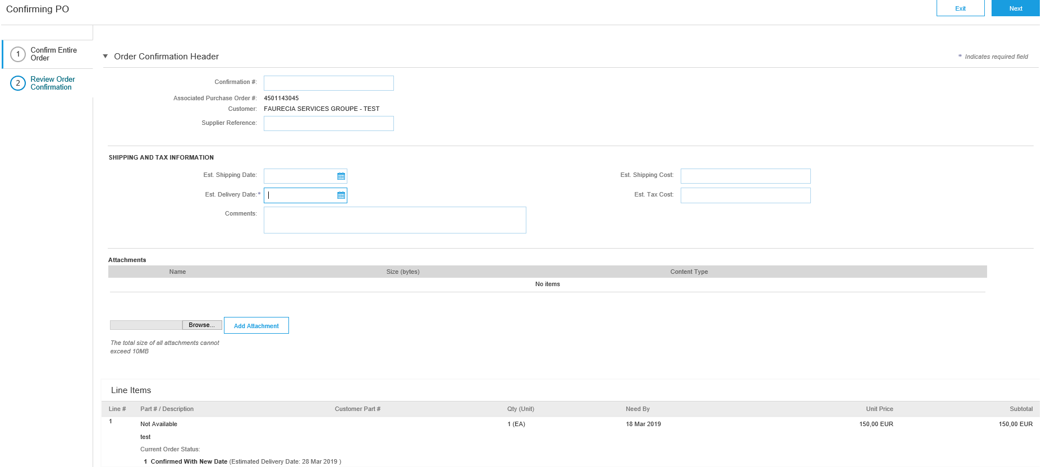
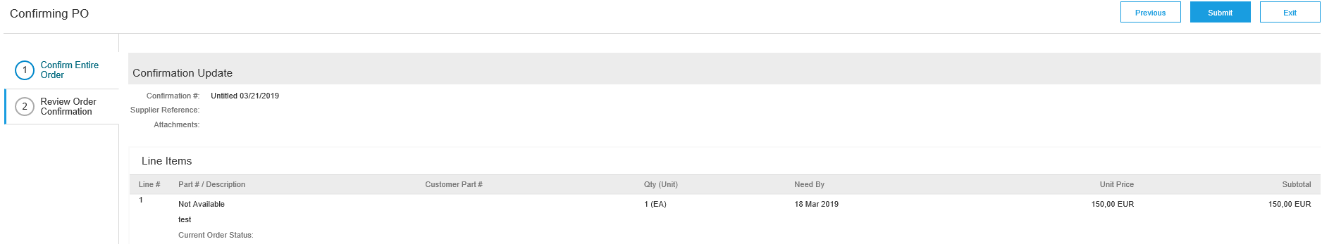
How to use the interactive e-mail – Create PO confirmation
Confirm Entire Order
2
Confirm Entire Order - fill in the necessary fields and press “Next”
Review Order Confirmation – Confirm and press “Submit”
1
2

Slide 29
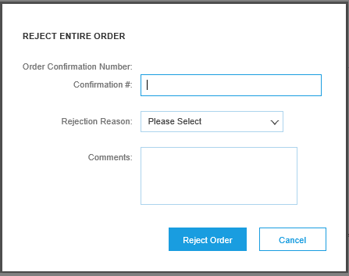
How to use the interactive e-mail – Create PO confirmation
Reject Entire Order
2
Reject Entire Order - fill in the necessary fields

Slide 30
How to use the interactive e-mail – Create Ship Notice
2
Create Ship Notice

Slide 31
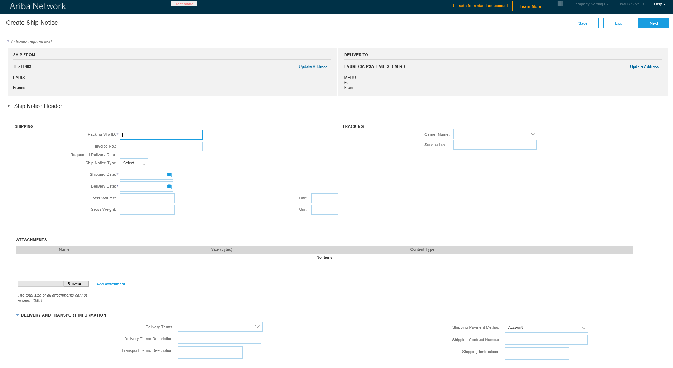
How to use the interactive e-mail – Create Ship Notice (1/3)
2
Create Ship Notice – fill in necessary fields (continues next slide)

Slide 32
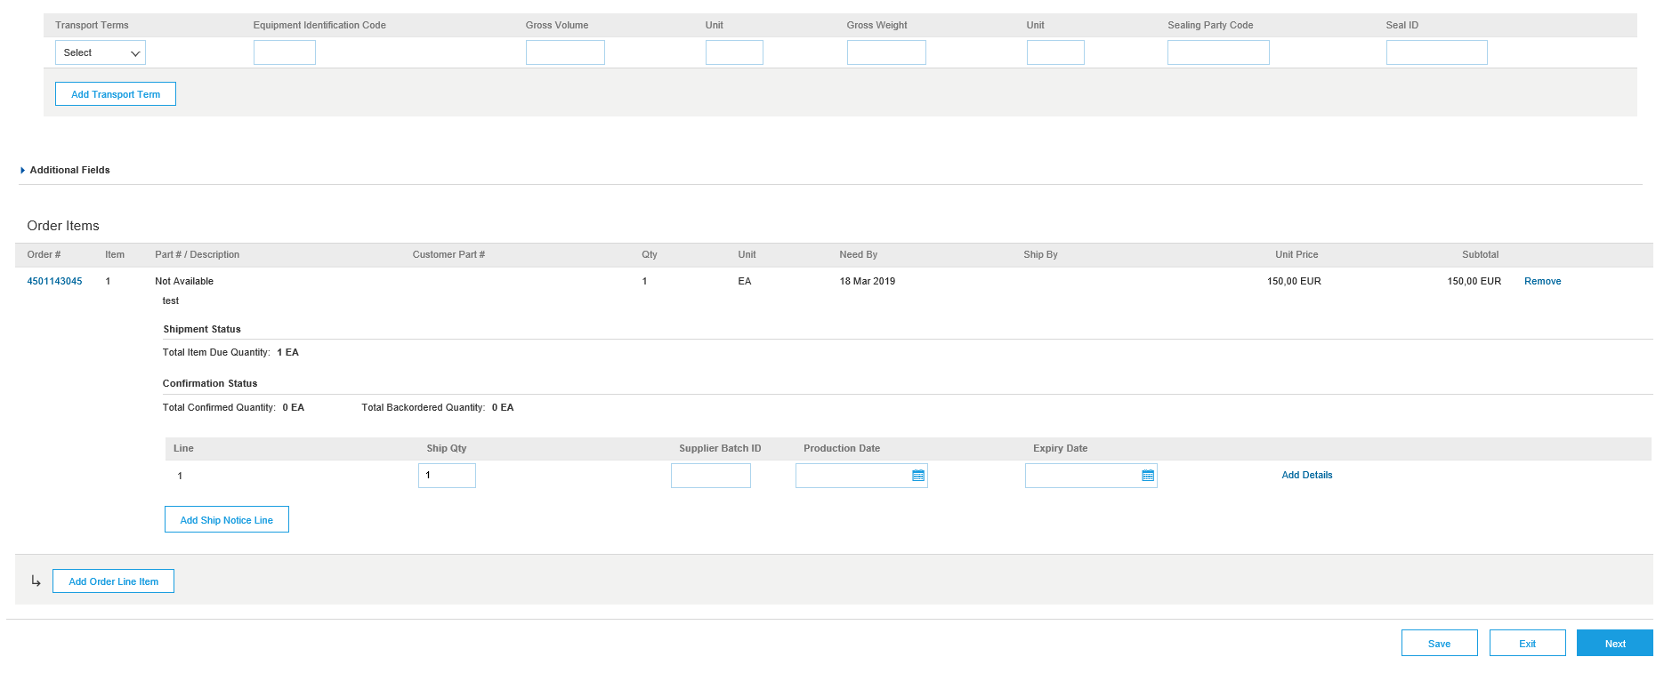
How to use the interactive e-mail – Create Ship Notice (2/3)
2
Create Ship Notice – Click “Next”

Slide 33
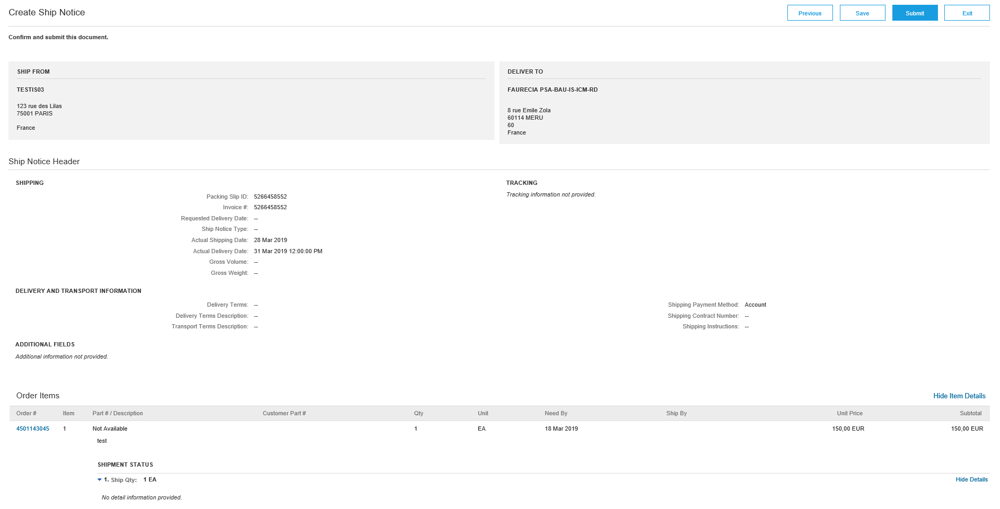
How to use the interactive e-mail – Create Ship Notice (3/3)
2
Create Ship Notice – Confirm information and click “Submit”

Slide 34
How to use the interactive e-mail – Create invoice
2
Click in “Create Invoice”

Slide 35
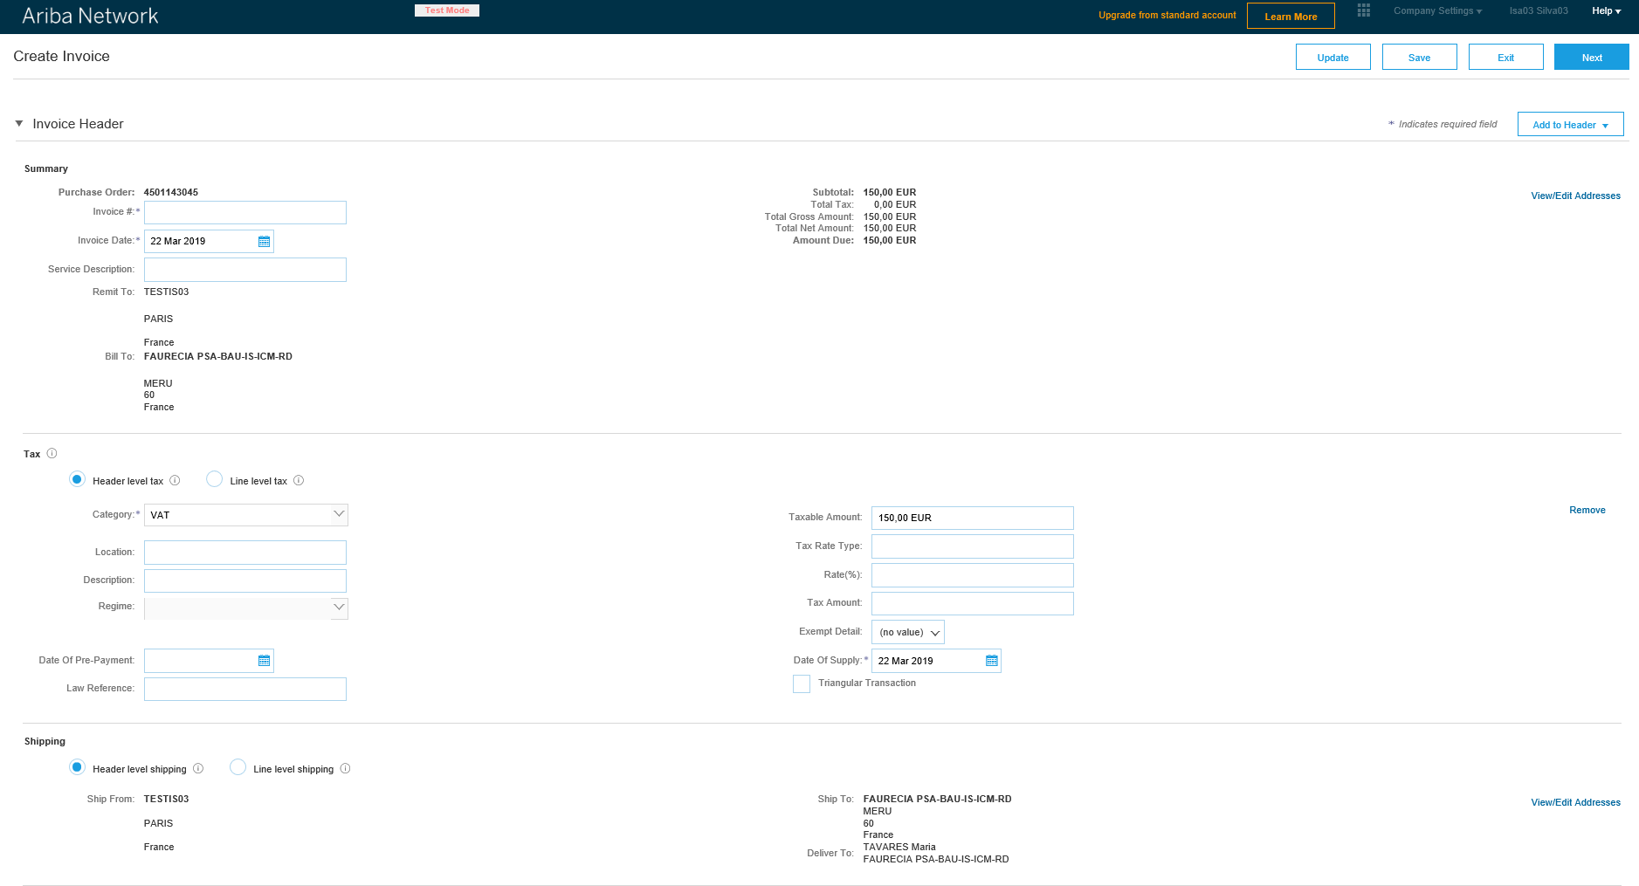
How to use the interactive e-mail – Create Invoice (1/3)
2
Create invoice - Fill in the necessary fields (continues next slide)

Slide 36
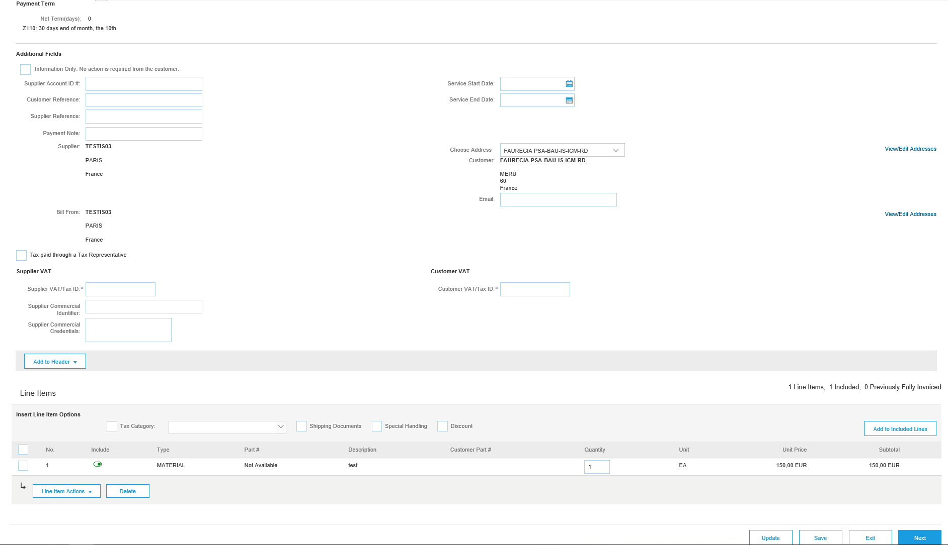
How to use the interactive e-mail – Create Invoice (2/3)
2
Create invoice - Fill in the necessary fields and click “Next”

Slide 37
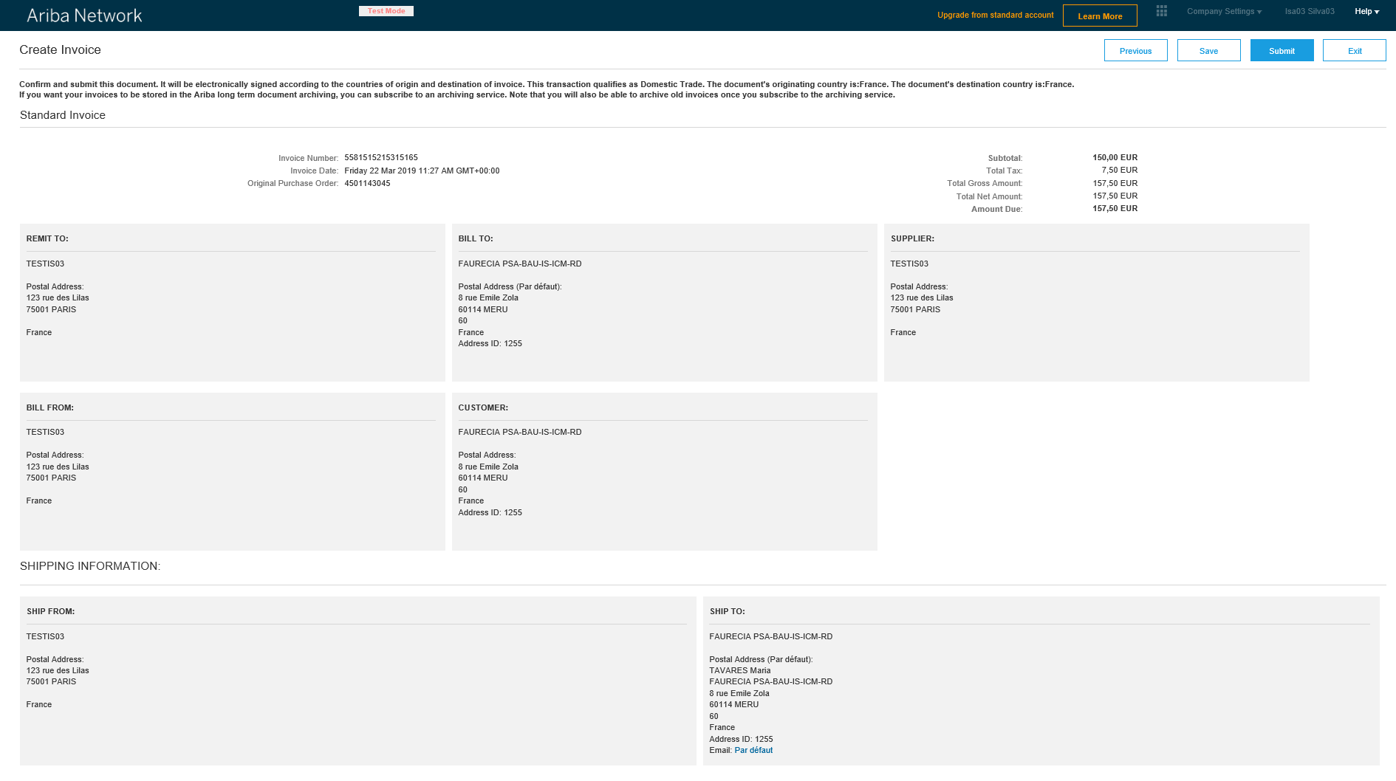
How to use the interactive e-mail – Create Invoice (3/3)
2
Create invoice – Confirm information and click “Submit”

Slide 38
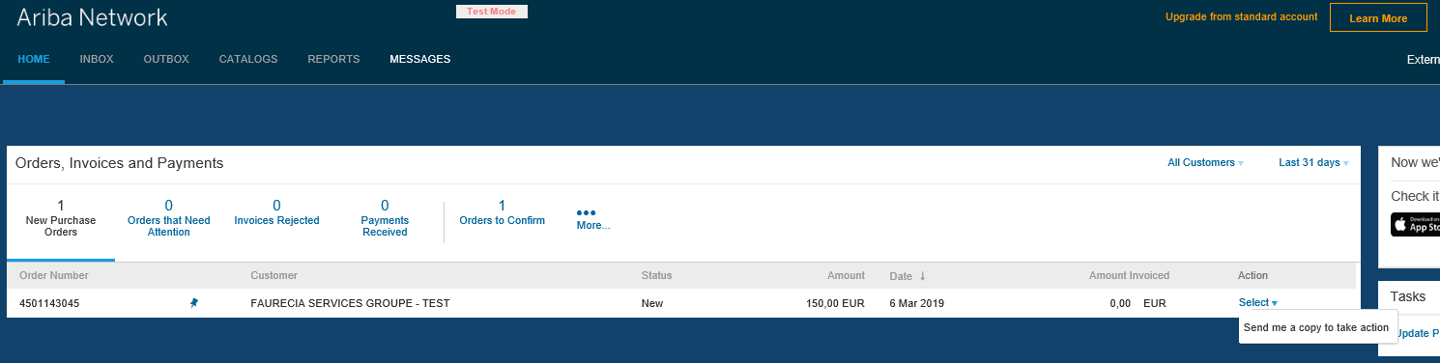
How to use the interactive e-mail – Lost PO
2
If you loose the PO go to Ariba Network:
  Step1 - Click “Select”
  Step 2 - Click “Send me a copy to take action”

Slide 39
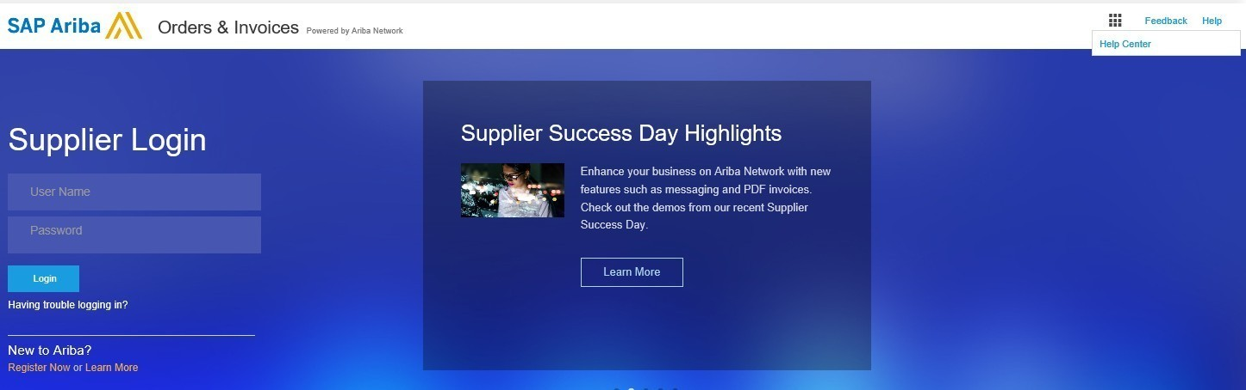
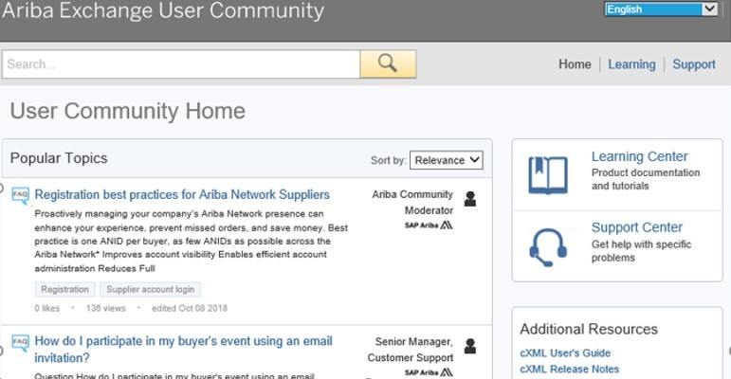
Ariba Support Access (1/3)
3

Slide 40
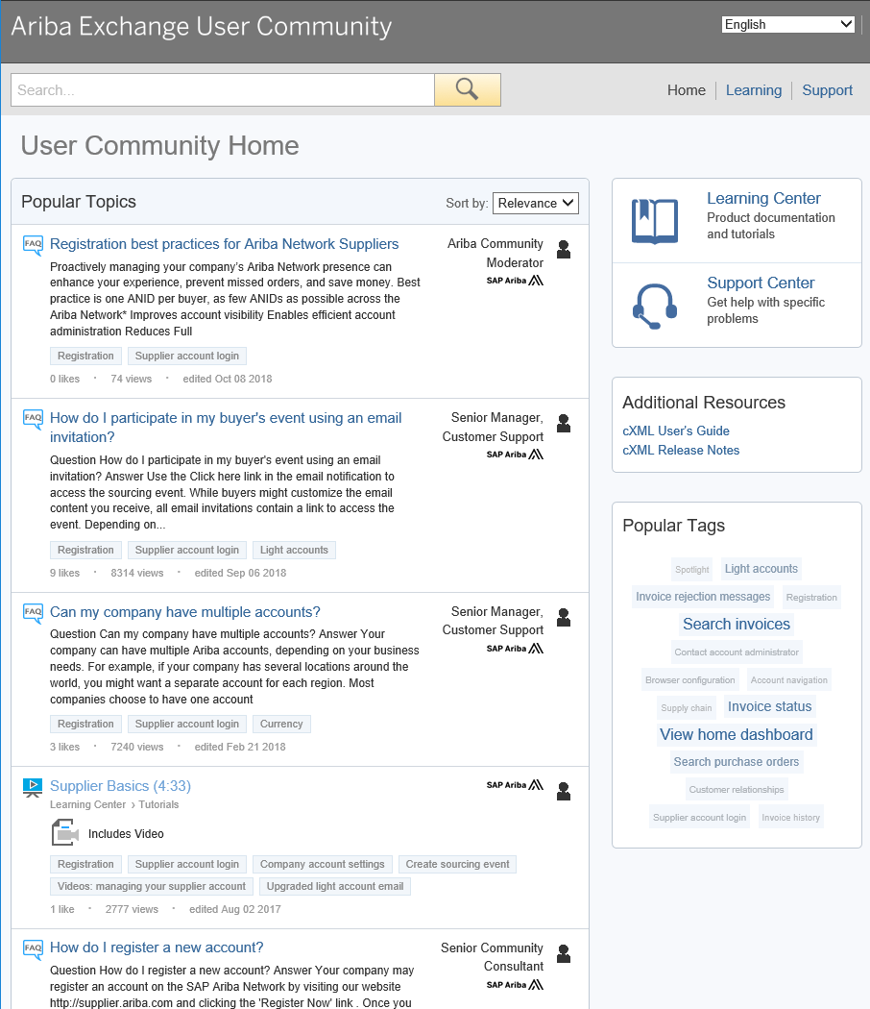
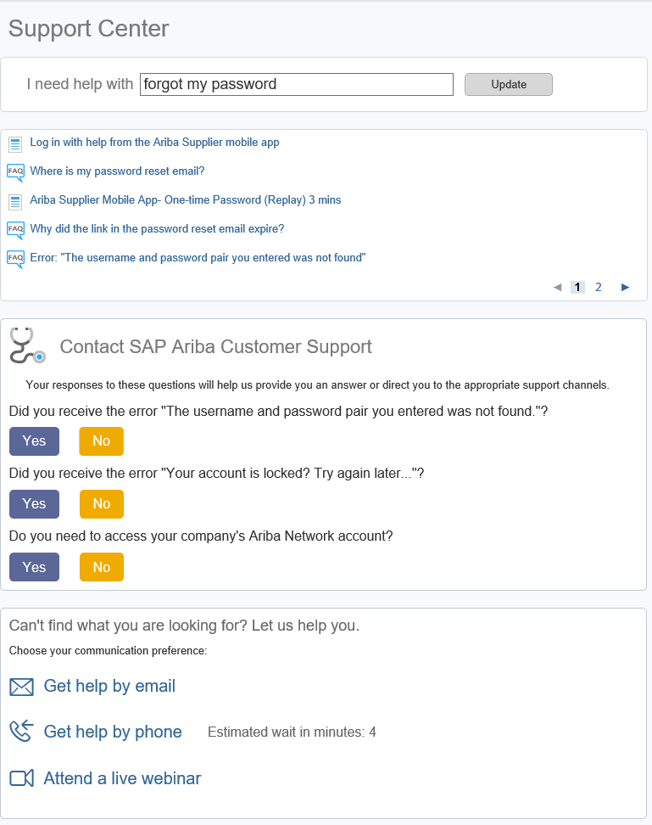

Ariba Support Access (2/3)
3
Search with key words
Try searching for whatever you need help with by using the I need help with search box.
If you need further support after conducting a search, the above mentioned support options will become available.

Slide 41
Ariba Support Access (3/3)
3
Questions regarding Ariba usage :
Please click on one of the below links for any questions regarding registration, configuration or general Ariba Network questions :
  USA/Canada : https://connectsupport.ariba.com/sites/Company?ANID=AN01274677429NAM&h=efiEiEb9GzUpOl83jqsNw#Enablement-Inquiry
  Brazil : https://connectsupport.ariba.com/sites/Company?ANID=AN01274677429BRZ&h=ZUMjmQJ1cv1AyRPHP4rNzA#Enablement-Inquiry
  Latin America: https://connectsupport.ariba.com/sites/Company?ANID=AN01274677429LAC&h=1a9ipmjaTdbyL4I4jaUcg#Enablement-Inquiry
  EMEA: https://connectsupport.ariba.com/sites/Company?ANID=AN01274677429EMA&h=aYCJ5Mm2uFBJv1T7QaeZ9A#Enablement-Inquiry
  SE Asia: https://connectsupport.ariba.com/sites/Company?ANID=AN01274677429SEA&h=kRV62sa3KWxd5CoBSswQ#Enablement-Inquiry
Questions regarding your relationship with Faurecia :
  EMEA
    Enterprise account : supplier.enablement.emea@faurecia.com
    Standard account : light.enablement.emea@faurecia.com
  North America
    Enterprise accounts : full.enablement.nao@faurecia.com
    Standard accounts : light.enablement.nao@faurecia.com
  China:
    Enterprise accounts : supplier.enablement.asia@faurecia.com
    Standard accounts : light.enablement.asia@faurecia.com

Slide 42


