Slide 1
How to: Respond to an RFQ
November 2019
Version 6

Slide 2
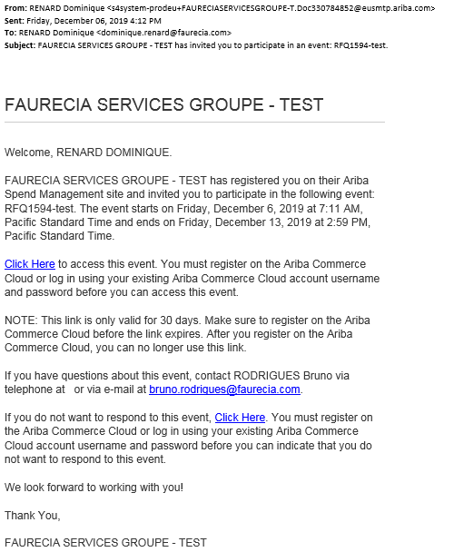
Be informed on new Resquest for Quote : By Mail (1/2)
From: Name of Faurecia Requester
By Mail
To: Name of Supplier Contact
What : RFQxxx – Title of the request
Information of maximum period to respond
Click on Ariba Sourcing Link , see next page

Slide 3
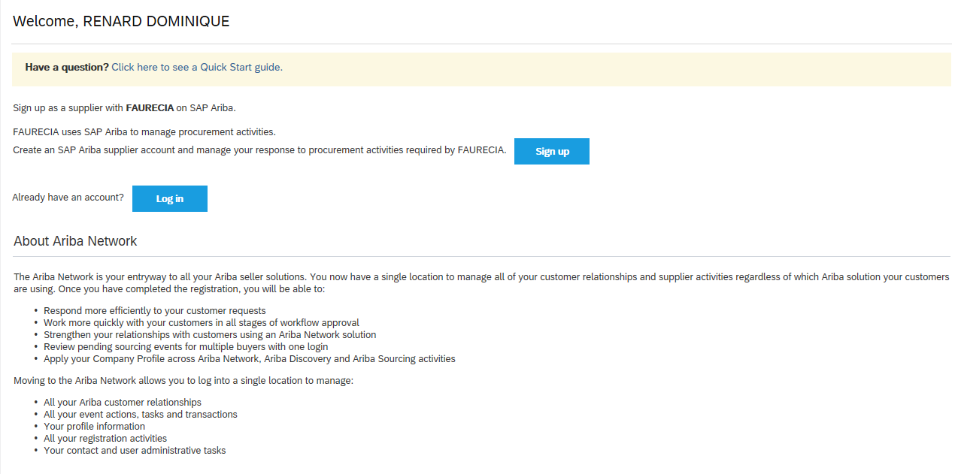
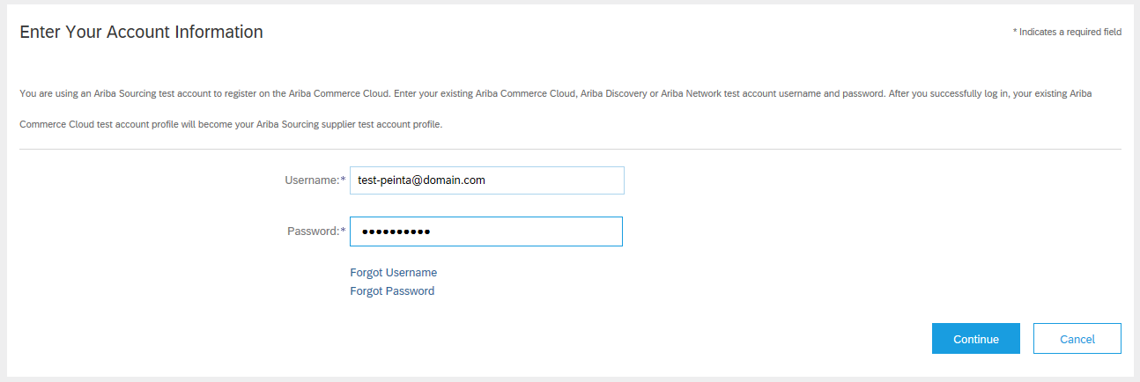
Be informed on new Resquest for Quote : By Mail (2/2)
Ariba Sourcing connection:
If you already have an account please click on Log In. If not , click on Sign Up
If at that step , you meet any difficulties please contact ARIBA Support Page (p10-11)

Slide 4
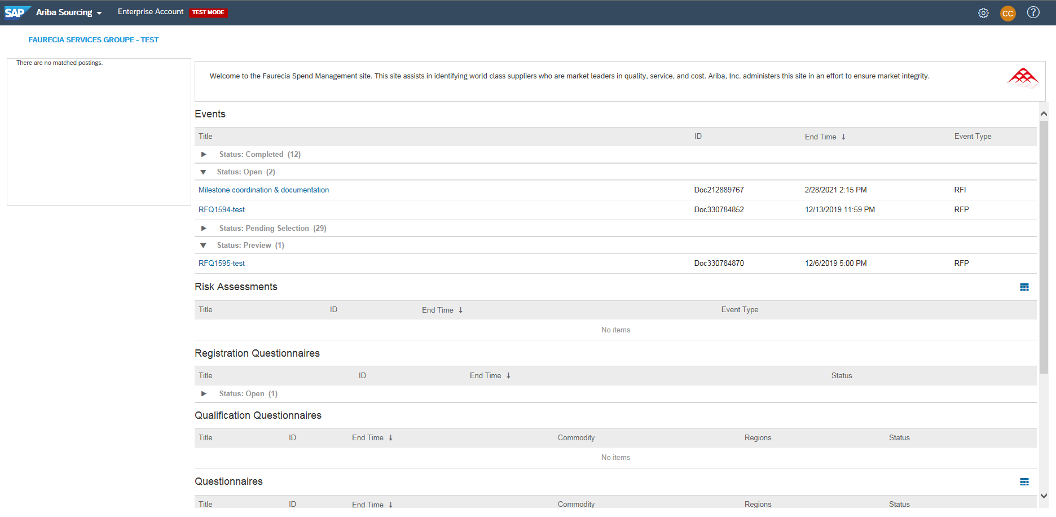
Be informed on new Resquest for Quote : via Ariba Sourcing
Connect to Ariba Sourcing Portal : https://service.ariba.com/Sourcing.aw/
Request for Quotation is called Event
Sorted by Status :
Open : RFQ to consult, and complete
Preview: future RFQ near to be Open
Pending selection : RFQ replied but waiting for award by Faurecia
Completed for closed RFQ (respond and award of offer done)

Slide 5
Respond to an Resquest for Quote : Confirmation of participation
By reviewing all content of RFQ , confirm your participation
The period to respond visible on top
All content area is providing :
“Ship To” address
Description of the request
Attachments

Slide 6
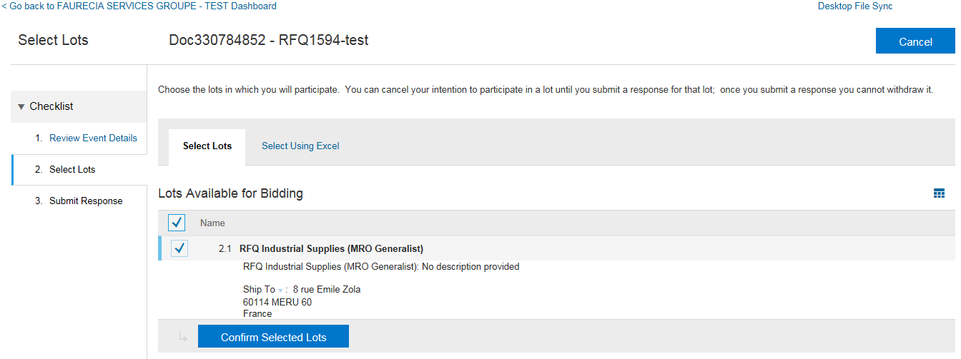
Respond to an Resquest for Quote : Select the Lot to be respond
Select the Lot and Confirm:
RFQ (Quick Quote) is containing only one Lot
Strategic sourcing (Sourcing Project) could contain more than one Lot

Slide 7
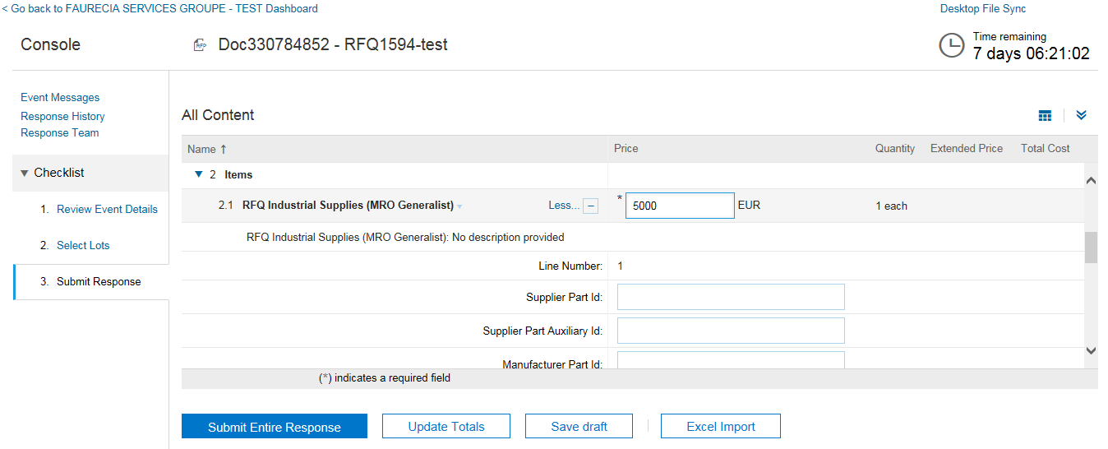
Respond to an Resquest for Quote : Submit response (1/2)
Complete the RFQ and submit:
RFQ ( Quick Quote) is described only by One Item with one global Price
Details must be provided in other fields such as “Comment” and “Attach a file” feature

Slide 8
Respond to an Resquest for Quote : Submit response (2/2)
Confirmation of the submit:
By “OK”, this message is appearing and click on “Done” :

Slide 9
Resquest for Quote Lyfecycle
During Remaining Bid Period, RFQ is still in Status “Open” and can be revised
Remaining Bid Period can be stopped by Faurecia to allow the Award phase. Then RFQ status is “Pending Selection”
RFQ in Status “Pending Selection” can be revised by the supplier. In certain circumstance, Faurecia is able to re-open the event giving possibility to do revision.
For any technical support please contact the ARIBA Support Chain
For any question on content of request please contact the requester
As last option of support, we are listing a Faurecia Support per region

Slide 10
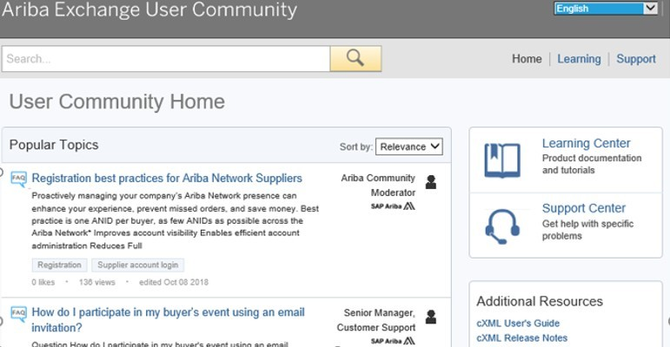
Ariba Support Access (1/3)

Slide 11
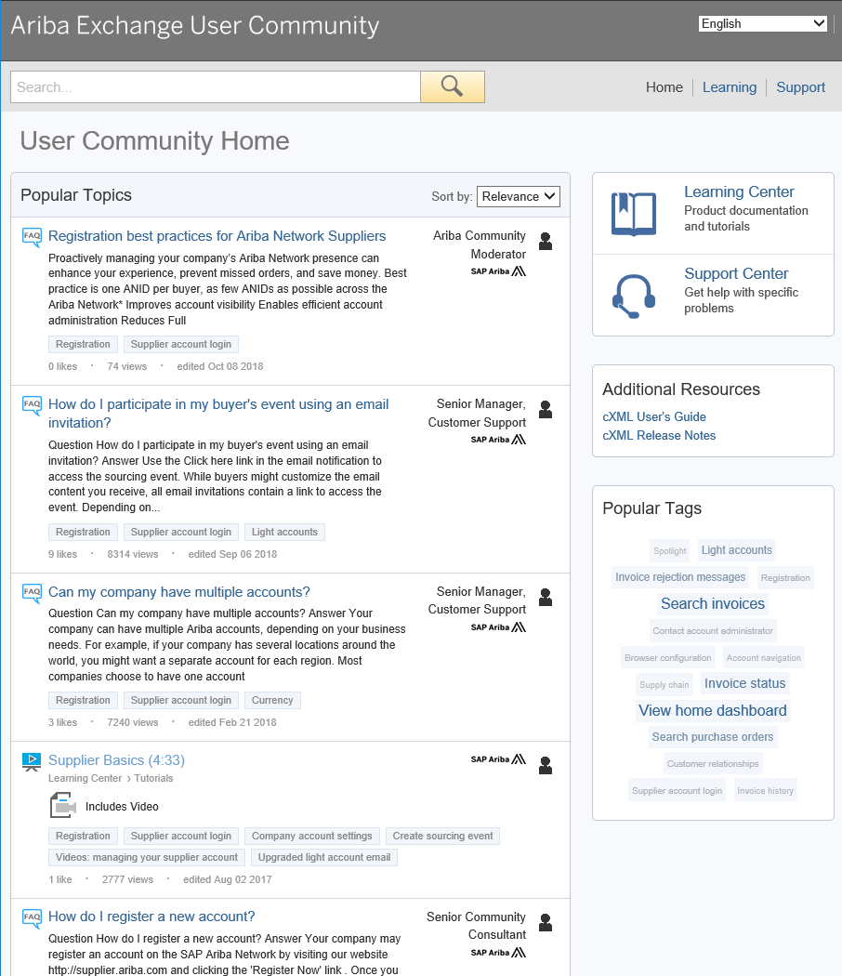
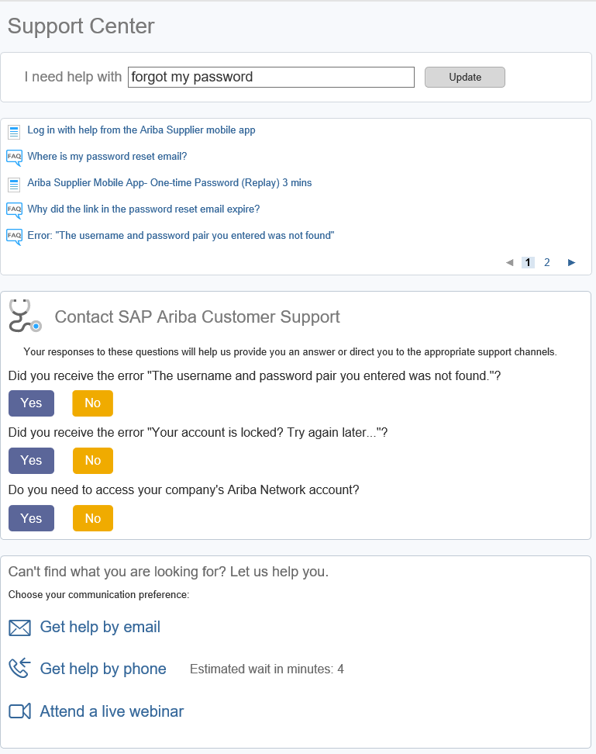
Ariba Support Access (2/3)
Search with key words
Try searching for whatever you need help with by using the I need help with search box.
If you need further support after conducting a search, the above mentioned support options will become available.

Slide 12
Faurecia Support (3/3)
Questions regarding Ariba usage :
EMEA : Faurecia.enablement@ariba.com
North America : Faurecia.enablement.namer@ariba.com
China: Faurecia.enablement.apj@ariba.com
Questions regarding your relationship with Faurecia :
EMEA
Enterprise account : supplier.enablement.emea@faurecia.com
Standard account : light.enablement.emea@faurecia.com
North America
Enterprise accounts : full.enablement.nao@faurecia.com
Standard accounts : light.enablement.nao@faurecia.com
China:
Enterprise accounts : supplier.enablement.asia@faurecia.com
Standard accounts : light.enablement.asia@faurecia.com

