Slide 1
SAP ARIBA Direct Purchasing
Supplier Guide:
Respond to Request for Proposal/Quote(RFP/RFQ) in ARIBA

Slide 2
Introduction
Information
Dear Supplier,
Faurecia has launched Ariba S2C, a new world class digital tool for end to end management of all Sourcing and Contract activities. With this new tool we are aiming to reduce the offline manual tasks and optimize the cycle times in sourcing process.
This Booklet will help you to onboard on this new journey with us. It will guide you right from Account Creation to Receiving RFQs, sending your bid proposals and agreeing to NDA and LON documents. In this booklet you can find step–by–step process to be followed with reference screenshots and key information. You will also get information on the support channels available in case of any blocking points.
Hope that with this guidance you can navigate on Ariba platform with ease and perform the required steps in sourcing process.
With Best Regards,
Faurecia Group Purchasing
2
Notes:
Plus en détail, voici ce qui va changer

Slide 3
Benefits for Suppliers
Information
Better relation with Faurecia
Better communication
Integrated sourcing module
Document status available at any time
1 Ariba account to manage multiple customers
Efficient procurement process
100% Paperless process integrated with your systems
Standardized & streamlined processes for all Faurecia entities
Reinforced compliance
Less administrative tasks
Digital collaboration with Faurecia
e-portal to share document (NDA, CBD, LON, contracts)
One single source of documents
One single purchasing channel with Faurecia
E-signatures and 1 click approvals
3
Notes:
Plus en détail, voici ce qui va changer

Slide 4
Information
Overview: Sourcing to Contract Process Flow in Ariba
Faurecia
Start
Accepts NDA
Sourcing Nomination Process and Business Award
Start of Business
Invite to RFP
Sr. No.
Quote Price
Review & Sign LON
Item 1
$
Item 2
$
NDA
Item 3
$
Item 4
$
Supplier(s) Input Quote price in the RFP event
Supplier(s)
4
Notes:
The Buyer Communicates the Raw PLM BOM extract to PSP for Uploading it to ARIBA Product Sourcing
And starts creating the full sourcing Project for the program
Once the BOM is uploaded in ARIBA Product Sourcing the Buyer may proceed with creating and RFP event for the Material in BOM
Buyer needs to complete the RFP event Process flow of Rules> Teams> Supplier>content and then cross check for all the details in Summary tab before publishing the RFP for suppliers to respond
Further the supplier have to agree to NDA and then the buyer will open the access for supplier by acknowledging the NDA signed by the Supplier
Supplier then input Quote price for the Material in RFP and submit
Once quote from all the suppliers is received then buyer needs to Stop the RFP event to avoid any changes to the quote price by supplier
Offline SNC is held and suppliers and identified for Award
Based on the awarded suppliers in SNC, Award scenarios are created in the RFP event
Connected to the Award scenarios contract workspace is created and LON approval along with Signature Task by all the internal and external signers will be started
Once the LON is signed the contract workspace is ready to be published and source.

Slide 5
Sourcing Project RFP – Be informed on new Resquest for quotation: by e-mail (1/3)
Faurecia - Supplier
1
Check for
Name of FAURECIA requestor if legitimate in the mail
Recipient email
Subject of mail with the RFQ title
To access the RFQ event
2
You will access the RFP event directly from Mail or by accessing ARIBA network
(Connect to Ariba Sourcing portal: https://service.ariba.com/Sourcing.aw/)
Once you Access the event from mail you will be taken to the Next screen

Slide 6
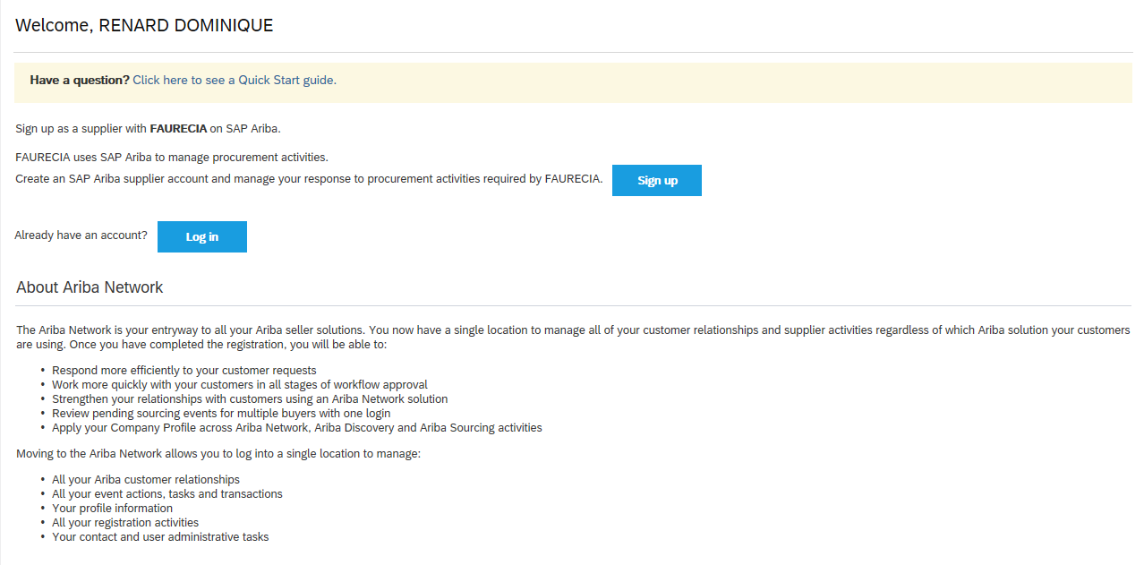
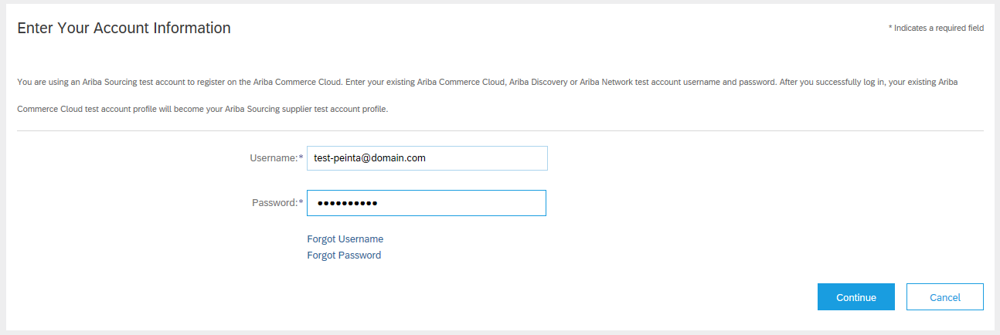
Sourcing Project RFP – Be informed on new Resquest for quotation: by e-mail (2/3)
Faurecia - Supplier
If you do not have an existing ARIBA user for your organization, new account can be created using “Signup” button on the screen
If already an ARIBA user is existing then you can directly “Log In” and access the event
i
If you already have an account please click on ‘Log in’ and enter your account information to begin
If you don’t have an account, click on ‘Sign up’ and create an account

Slide 7
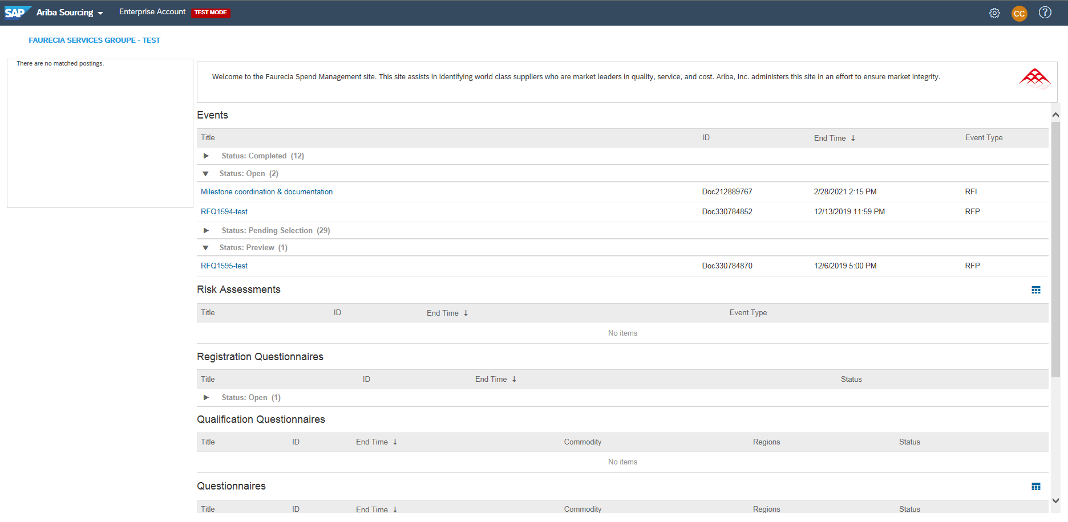
Sourcing Project RFP – Be informed on new Resquest for quotation: by e-mail (3/3)
Faurecia - Supplier
Click on the “event name” to open
Request for Quotation is called ‘Event’
“Events” are Sorted in Ariba by status:
Open: RFQ to consult, and complete the response
Preview: future RFQ approaching opening time / date for quotes
Pending selection: RFQ reply sent, but waiting for award by Faurecia
Completed: closed RFQ (response and award of offer done)
To open the Event Click on the event and the you will have the next window

Slide 8
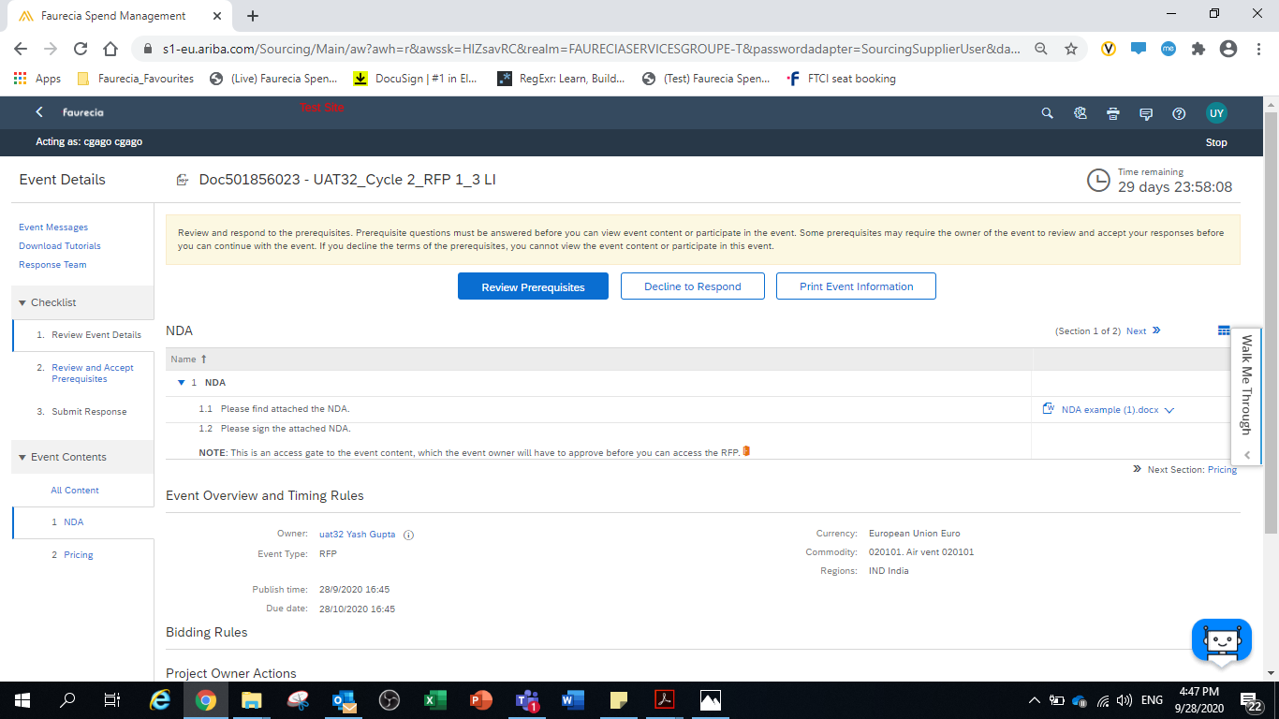
Sourcing Project RFP – Supplier Review & Response to NDA
Faurecia - Supplier
2
1
Download NDA from Here
Supplier access the RFP event from Mail or ARIBA network
Here the supplier will review the RFP event and Download the NDA provide their acceptance by uploading the signed copy of the NDA
To submit the signed NDA go to “Review Prerequisites”

Slide 9
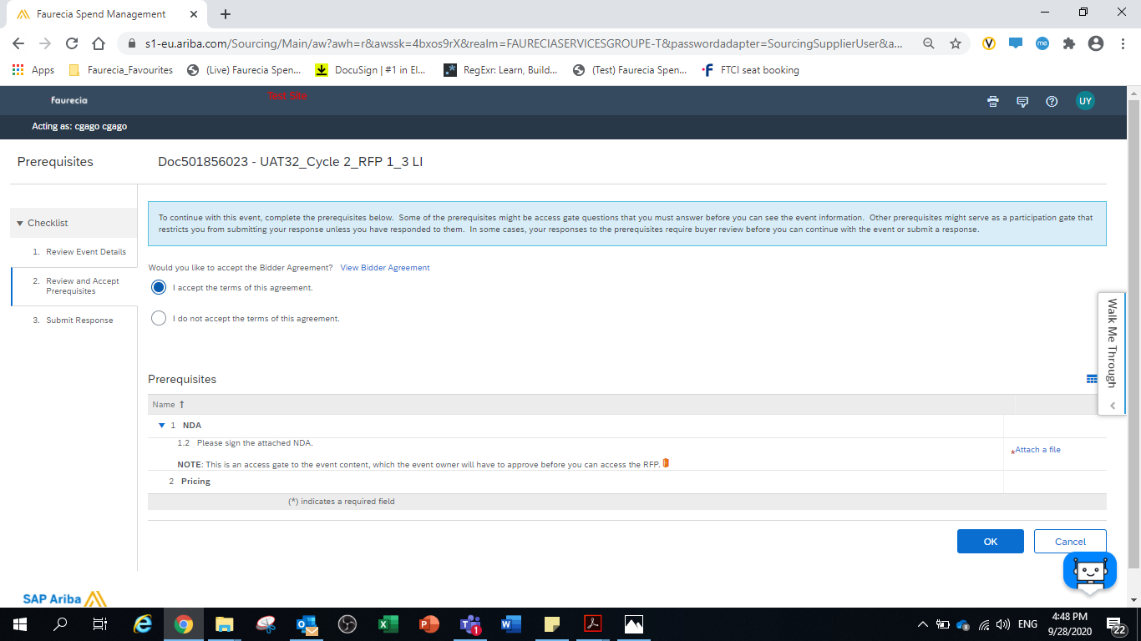
Sourcing Project RFP – Supplier Review & Response to NDA
Faurecia - Supplier
1
2
Attached the signed NDA here
To attach the Signed NDA go to “Attach file”
select “I accept the terms of main agreement”

Slide 10
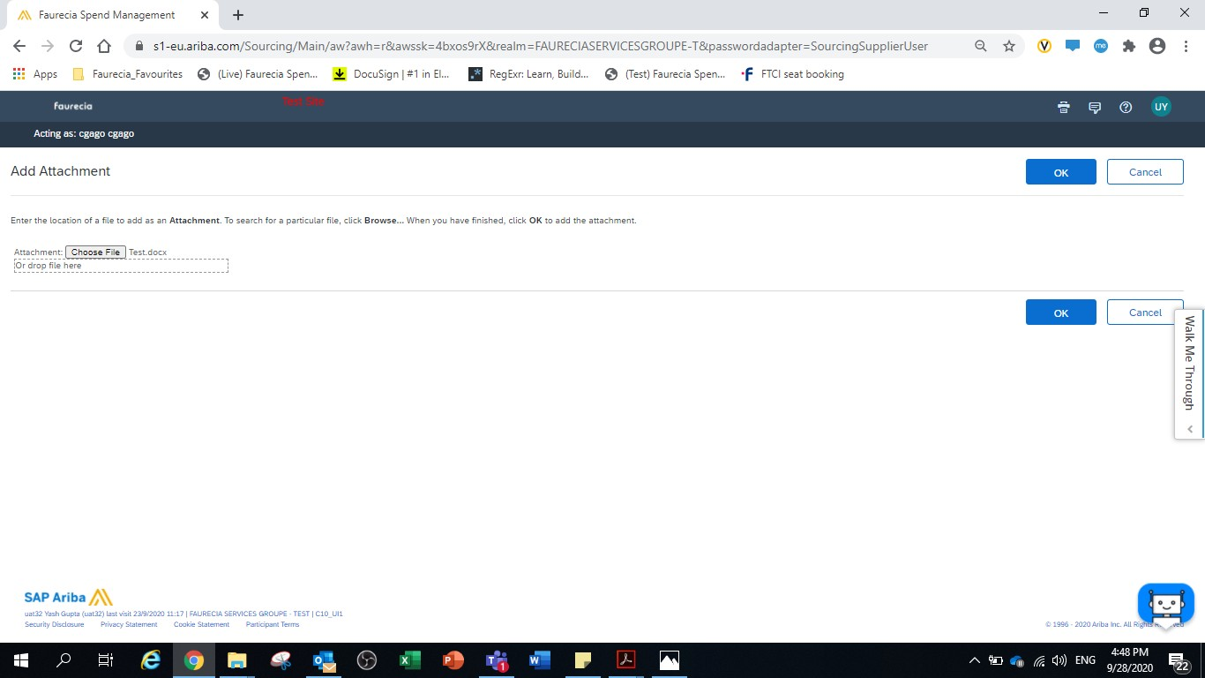
Sourcing Project RFP – Supplier attach Signed NDA
Faurecia - Supplier
1
2
Choose Or Drag & Drop the Signed NDA file to be attached

Slide 11
Sourcing Project RFP – Supplier Review & Response to NDA
Faurecia - Supplier
After the Terms have been accepted and signed NDA has been attached, please click on OK”

Slide 12
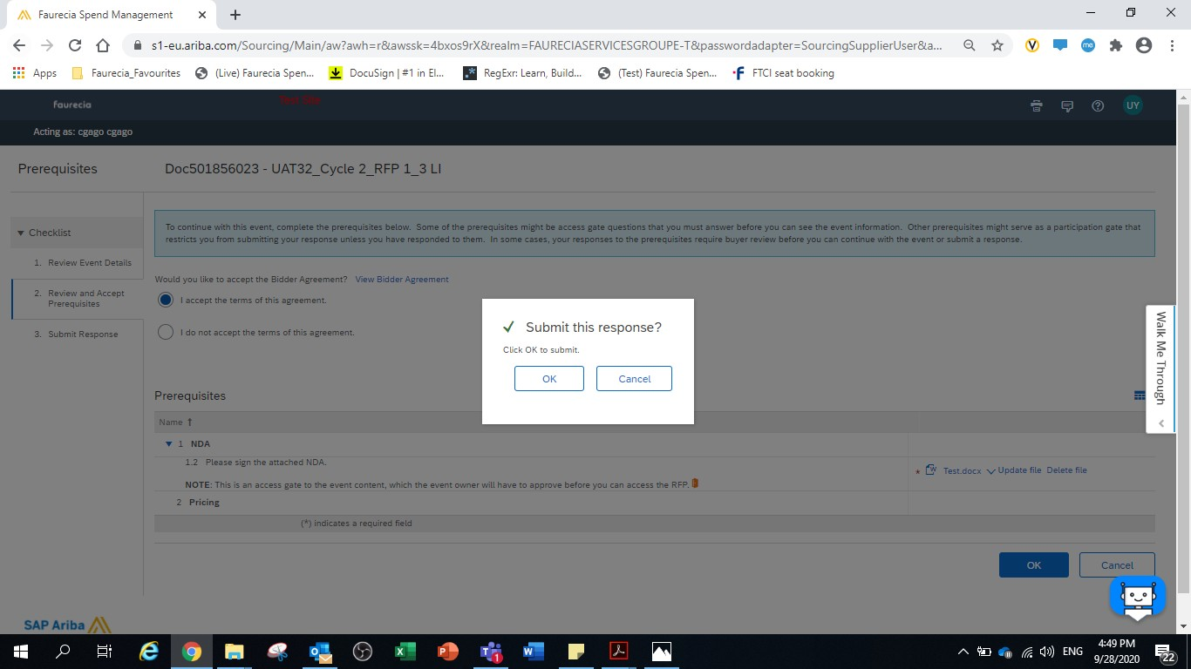
Sourcing Project RFP – Supplier Submits NDA
Faurecia - Supplier
click on “OK” after attaching the NDA and accepting the main agreement terms to submit the Response for NDA
Confirmation of Submission will be given by system

Slide 13
Sourcing Project RFP – Supplier Submits NDA (waiting for Buyer to Acknowledge NDA and accept)
Faurecia - Supplier
At this stage you have to wait for the Faurecia Buyer Approval for your NDA to go further on the process

Slide 14
Sourcing Project RFP – Signed NDA Accepted (Supplier now can start Quoting)
Faurecia - Buyer
Only after the NDA is accepted by Faurecia Buyer, you will be able to view the RFP Bidding file to respond with your Quotation

Slide 15
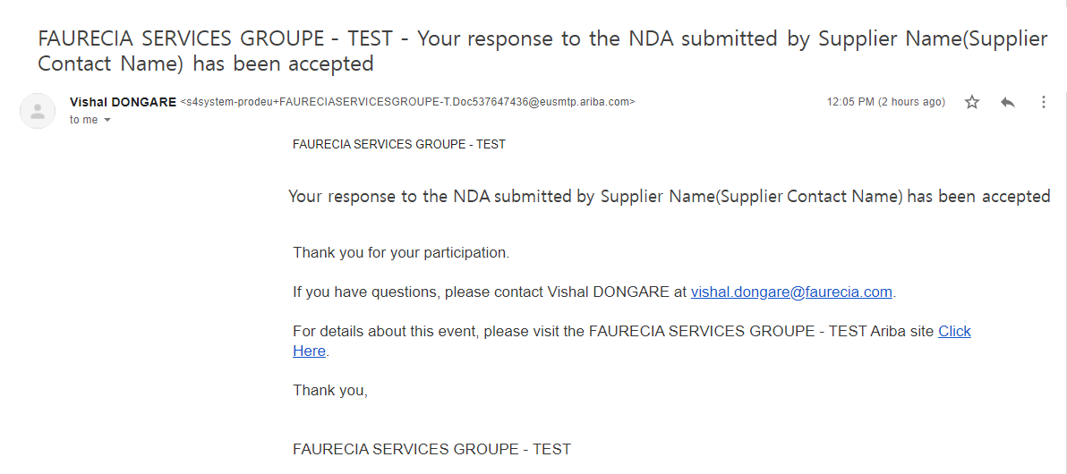
Sourcing Project RFP – Email to Supplier on NDA acceptance
Faurecia - Supplier
This is a mail you will receive once the Faurecia Buyer has accepted the NDA and opened the access gate to the content of RFQ
i
After Buyer has acknowledged the NDA, you will go to “Compose Response” to further proceed for bidding

Slide 16
Sourcing Project RFP – Access the Event after Faurecia Buyer has Accepted the NDA
Faurecia - Supplier
Click on the “event name” to open
To again access the Event Login to ARIBA Network click on the Right event to be accessed to start quoting

Slide 17
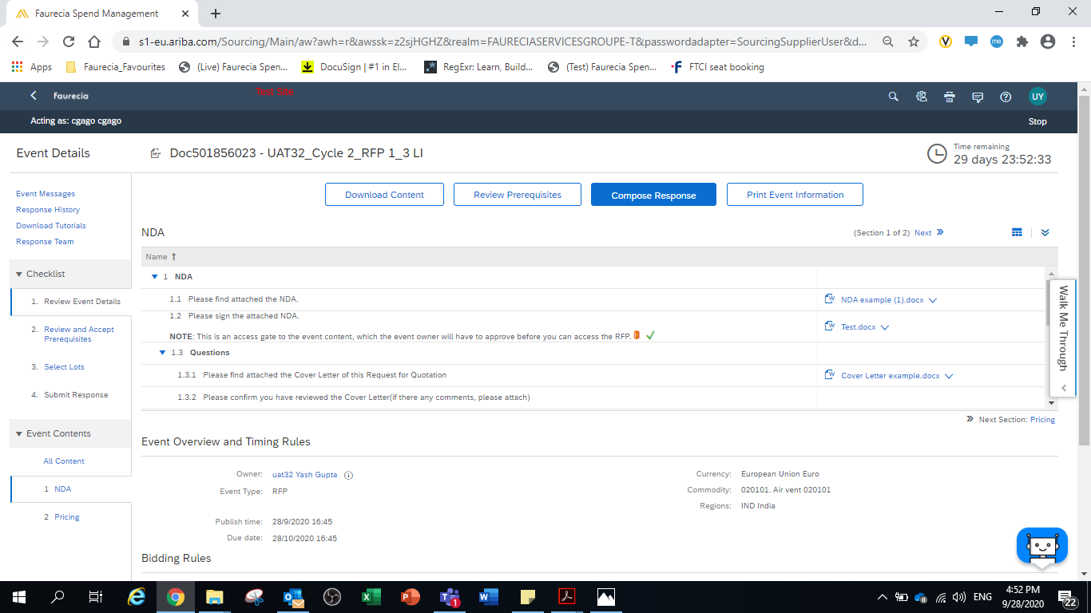
Sourcing Project RFP – Supplier Compose Response for RFP
Faurecia - Supplier
After Buyer has acknowledged the NDA, you will go to “Compose Response” to further proceed for bidding

Slide 18
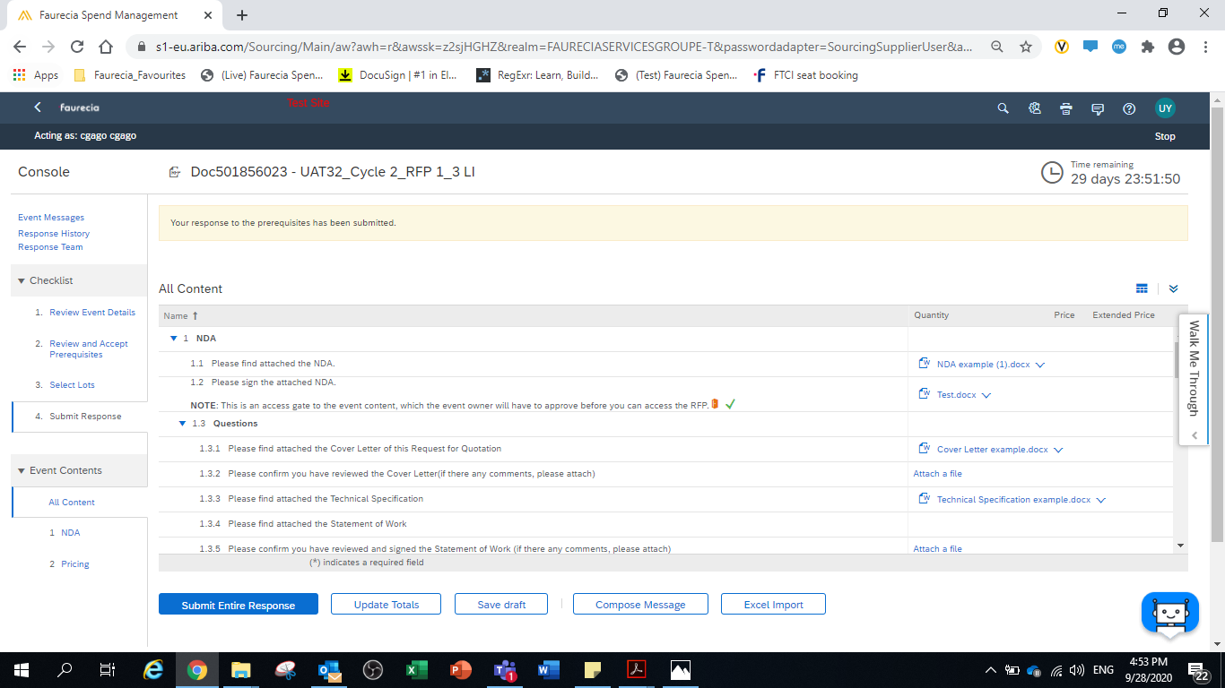
Sourcing Project RFP – Excel Import
Faurecia - Supplier
At this step, supplier will have to answer to all the Questions within RFP
To further download the Bidding file go to > Excel Import

Slide 19
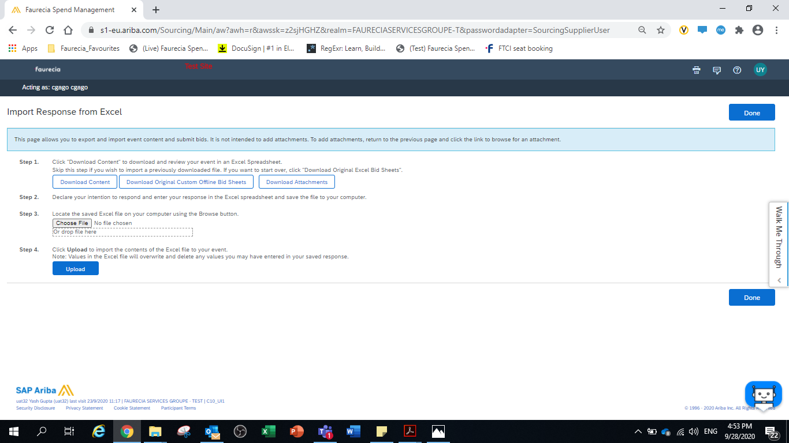
Sourcing Project RFP – Excel Import
Faurecia - Supplier
To download the Bidding file go to > Download Content > click on Done
Go offline to the downloaded Bidding file(Cost Breakdown_CBD) to start adding details and quoting price for Materials as per RFP
Note : - once the bidding file is updated with quote price come back to this page and upload the file.

Slide 20
Sourcing Project RFP – Offline Cost Breakdown file update
Faurecia - Supplier
For further support on the CBD file on how to Read and Populate right data within you may contact the Responsible Faurecia Buyer

Slide 21
Sourcing Project RFP – Excel Import
Faurecia - Supplier
To further Submit your proposal to the Faurecia Buyer Access the Event and Upload the Bidding file, go to > Excel Import

Slide 22
Sourcing Project RFP – Excel Import
Faurecia - Supplier
To Upload the Bidding file go to > Choose File> click on Upload

Slide 23
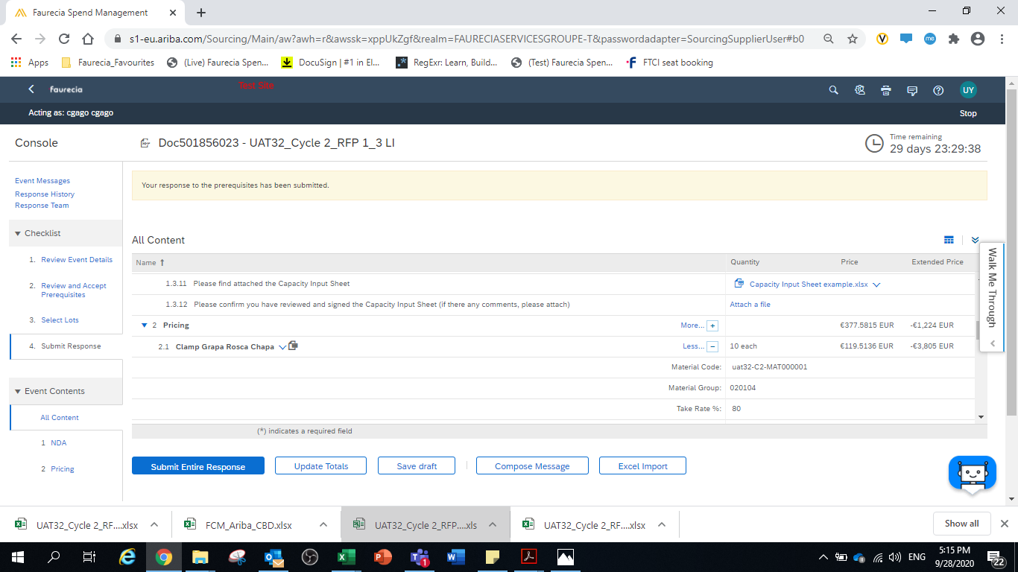
Sourcing Project RFP – Submit Entire Response
Faurecia - Supplier
2
1
After the file has been uploaded successfully click on “Update Totals” to view the pricing on the screen
To Submit the Bid Click on “Submit Entire Response”

Slide 24
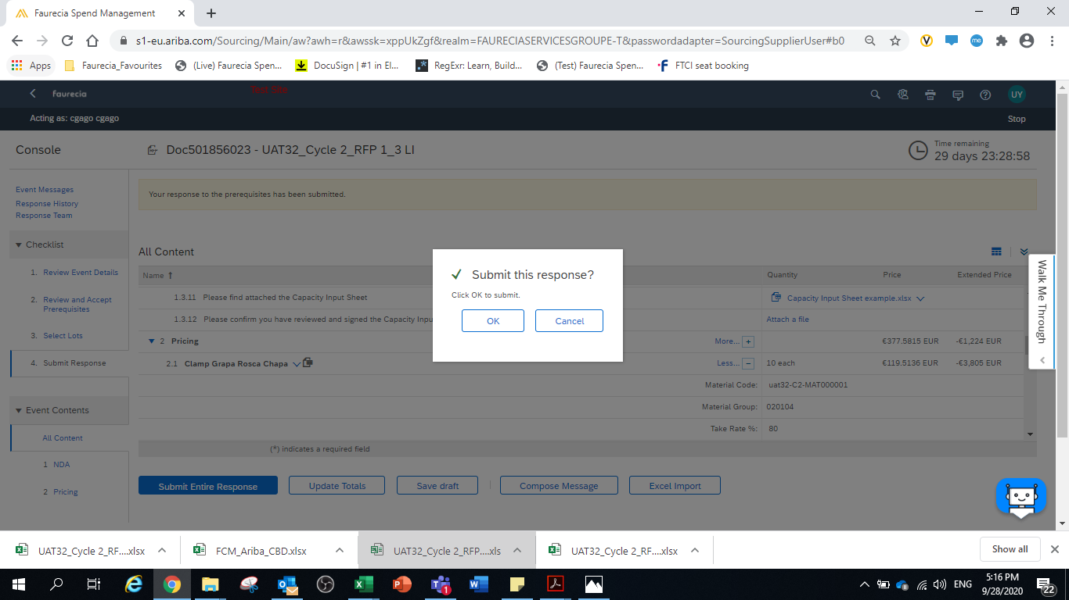
Sourcing Project RFP – Submit Entire Response
Faurecia - Supplier
Click on “OK” to submit

Slide 25
Resquest for Quotation lifecycle
Information
During remaining bid period, RFQ is in status “open” and can be revised
RFP event should be stopped by Faurecia Buyer to allow it to enter the “Award phase”. Then RFP status is “Pending selection”
In certain circumstance, Faurecia is able to re-open the event giving possibility to do revision.
For any technical support please contact Ariba Support
For any questions on content of request please contact the requester
As last option of support, we are listing a Faurecia Support contacts

Slide 26
How to Sign a contract in Ariba

Slide 27
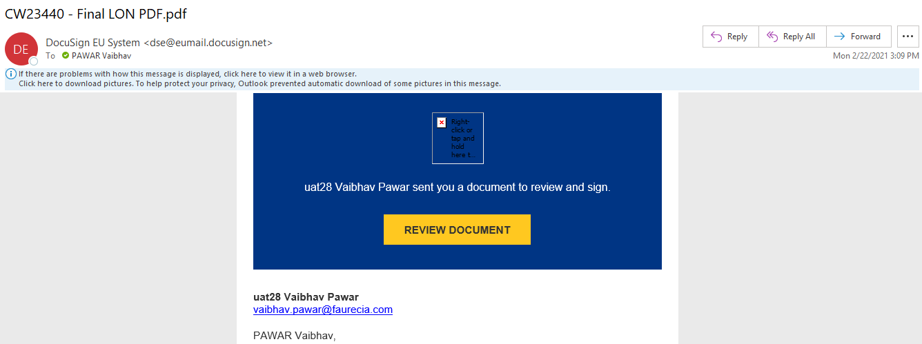
Contract Signing by Supplier – Supplier receives the Email
Faurecia - Supplier
To access the Final LON document
Supplier contact will access the Final LON document directly from email received after business award
Click on review Document to proceed

Slide 28
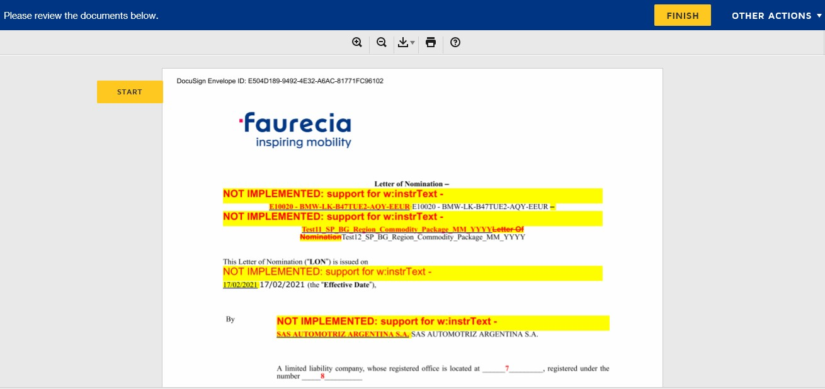
Contract Signing by Supplier – Redirected to DocuSign
Faurecia - Supplier
Click on Start
After clicking on review document it will automatically redirect to the DocuSign for signing the LON document
Supplier will click on “Start” to proceed with the task

Slide 29
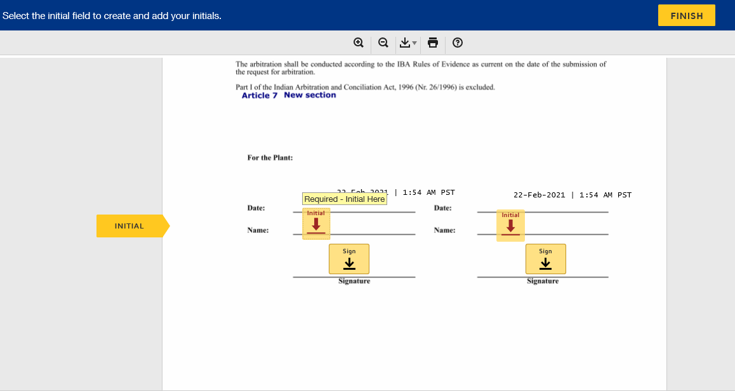
Contract Signing by Supplier – Click on Date ,Initial and Sign
Faurecia - Supplier
Click on Start
Here Supplier will click on Date , Initial and Sign for the Electronic Signature on the document

Slide 30
Contract Signing by Supplier – Click on Date ,Initial and Sign
Faurecia - Supplier
After signing completed the final document will have signature on Letter of Nomination (LON)

Slide 31
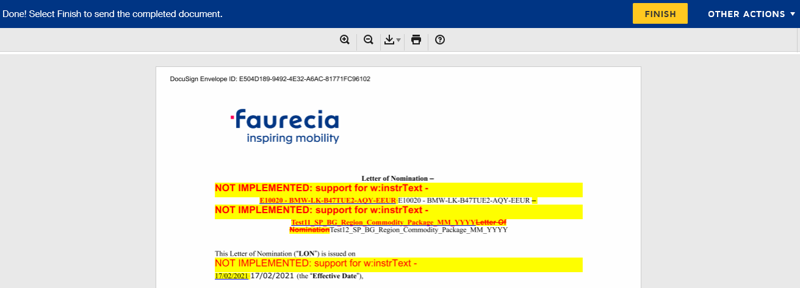
Contract Signing by Supplier – Click on Date ,Initial and Sign
Faurecia - Supplier
Click on Finish
At the Final Step , Supplier will click on finish button to complete the signing process of LON.
Once finished the process both the parties as Supplier and Faurecia will receive the signed LON PDF in Email

Slide 32
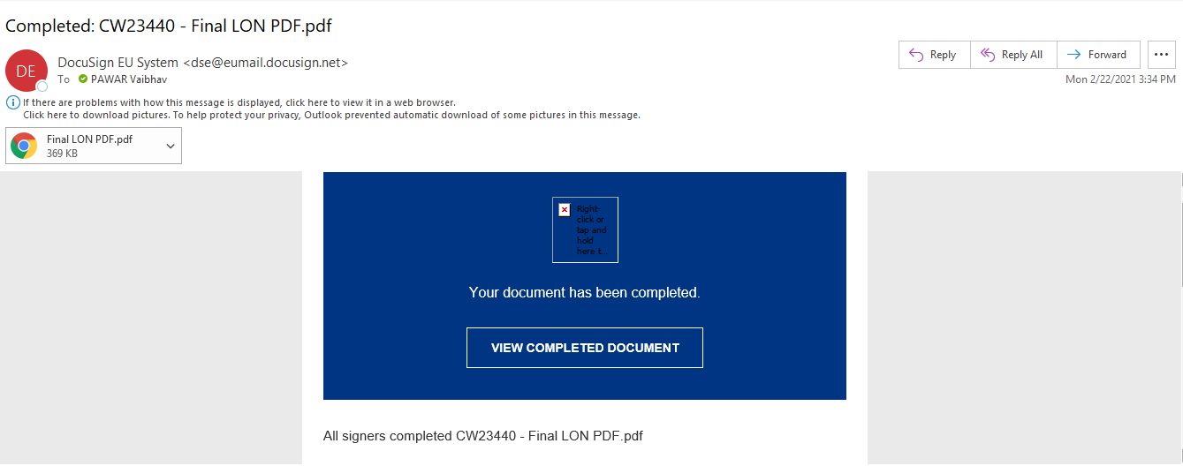
Contract Signing by Supplier – Final LON PDF in Email
Faurecia - Supplier
Completion email from DocuSign with attached LON PDF signed by supplier

Slide 33
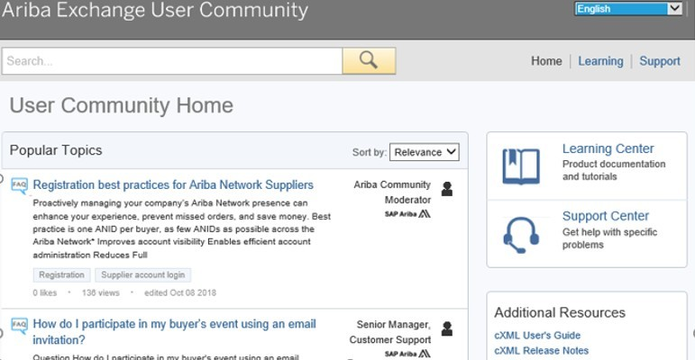
Ariba support Access
Information
33

Slide 34
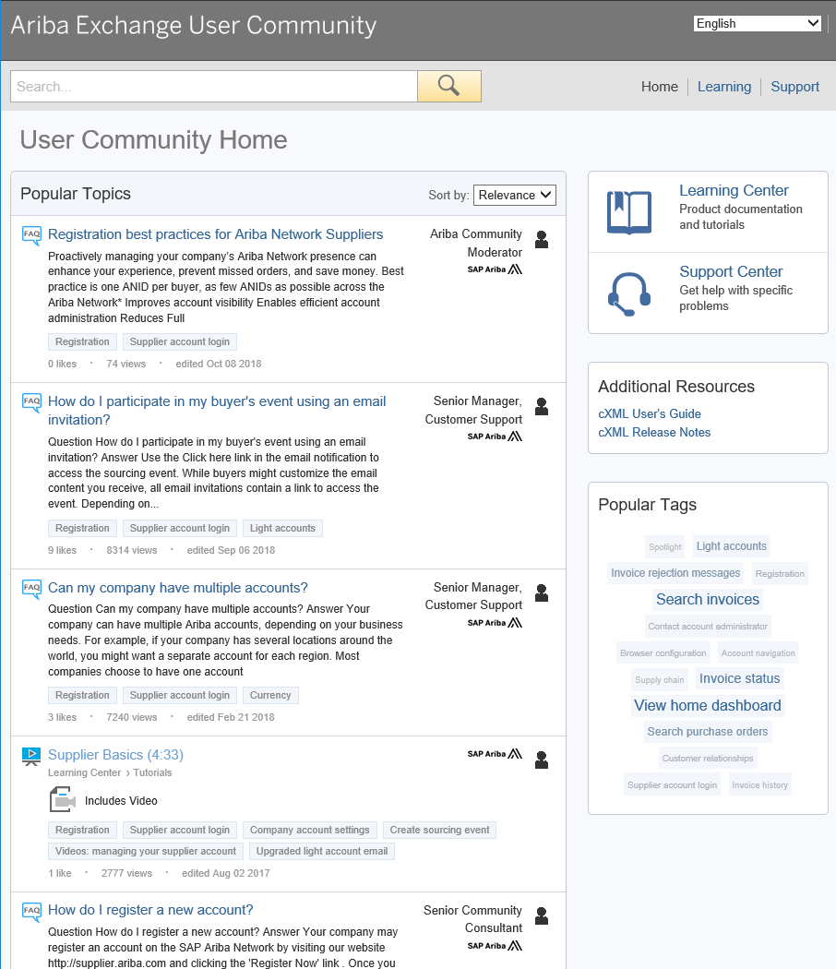
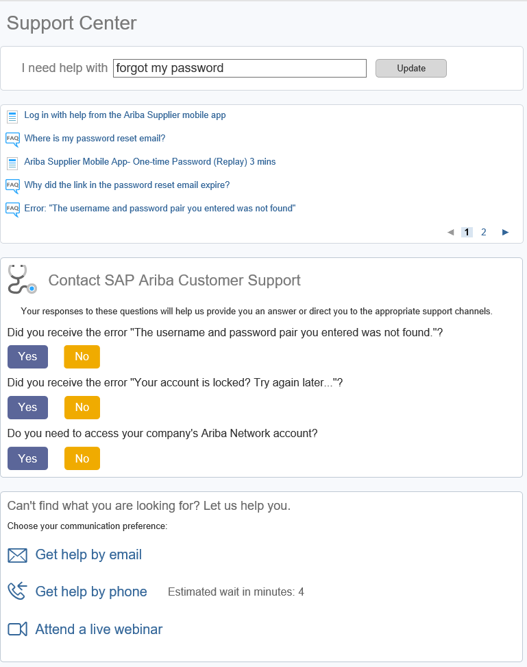
Ariba support Access (2/3)
Information
Search with key words
Try searching for whatever you need help with by using the I need help with search box.
If you need further support after conducting a search, the above mentioned support options will become available.
34

Slide 35
Ariba support Access (3/3)
Information
Questions regarding RFP event in Ariba : ariba.support_supplier@faurecia.com
Direct messenger in Ariba tool

Slide 36
Ariba S2C: Supplier FAQs
Information
Why do suppliers need to register?
→ In order to participate in Ariba Sourcing events (e.g. to respond to RFPs and for submitting proposals its necessary for supplies to register on the Ariba Network
I already have an ANID (Ariba Network ID), do I need a second one for the Supplier Registration?
→ If you already have an ANID that you use for Ariba, then you do not need a second ID, simply log in with your username and password on Ariba Network
How will we get notifications about new RFQ or status updates?
→ Email notifications will be sent to the supplier contact person. The primary contact person will receive all status updates, notifications. Suppliers are able to maintain their primary contact person and other designated user’s roles via SAP ARIBA network
What if Invite is send to the wrong contact from supplier organization?
→ You should not forward the invitation but rather get in touch with the Faurecia Contact mentioned on the invitation and ask for sending the invitation to correct user within your organization.

Slide 37
Ariba S2C: Supplier FAQs
Information
I tried to sign up but after completing the form I get the following error: There has been an issue updating the Sourcing document?
Please login via supplier.ariba.com with your user name and password and then you should be able to access the questionnaire
What would be the impact on running business/process (e.g. Payment/billing, bidding etc.), during suppliers profile update, migration and go live?
Existing contract(s) will not be impacted
In CBD template under which tab as a supplier pricing information needs to be filled in?
→ Suppliers will have to provide the pricing in different tabs according to list of parts for which price needs to be Provided and then in “Pricing” Tab there is mapping for all the data entered within the sheet

Slide 38
Ariba S2C: Supplier FAQs
Information
Can the supplier will be able to change their quote price submitted for the RFP event ?
→ Yes , Supplier can change the quote price as many times till the time event is Open and once event is stopped by Buyer then afterwards suppliers will not be able to change their pricing further
What all document supplier will have to fulfill in the RFP along with the pricing details ?
→ NDA , Cover Letter , Capacity Commitements , Technical Spécifications , Feasibility Commitements ,Quality Commitements , SOW , LPDS Etc.
Do supplier Need the DocuSign account for signing LON document ?
Yes , Once the supplier contact receive the email from DocuSign(After submitted by PSP) for signing purpose , Only for the first time use suppliers needs to create their DocuSign account by adding some basic details and then can sign the document and submit the Task
How to upload the NDA Inside Ariba and agree on the terms and conditions?
→ After clicking the link provided in the email coming from Ariba network for invitaton for the RFP event
Suppliers Will be automatically redirected to the page where they can Download→Review→Sign→Scan→Upload back in the Ariba Network. Once uploaded then suppliers needs to agree on the terms of Agreement for completion of task

